Slide 1
WELCOME !!!
Notes:
3:00 – 3:05

Slide 2
You are part of an important national effort.
Notes:
3:05

Slide 3
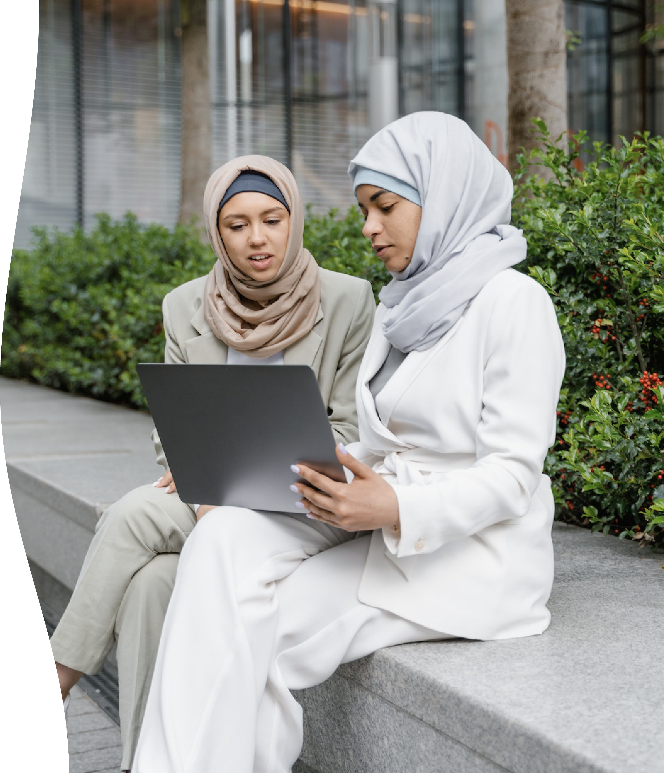
Heading?
Notes:
Emphasize that it all centers on their insights, lived experience, and community based wisdom

Slide 4

Heading

Slide 5
Heading

Slide 6
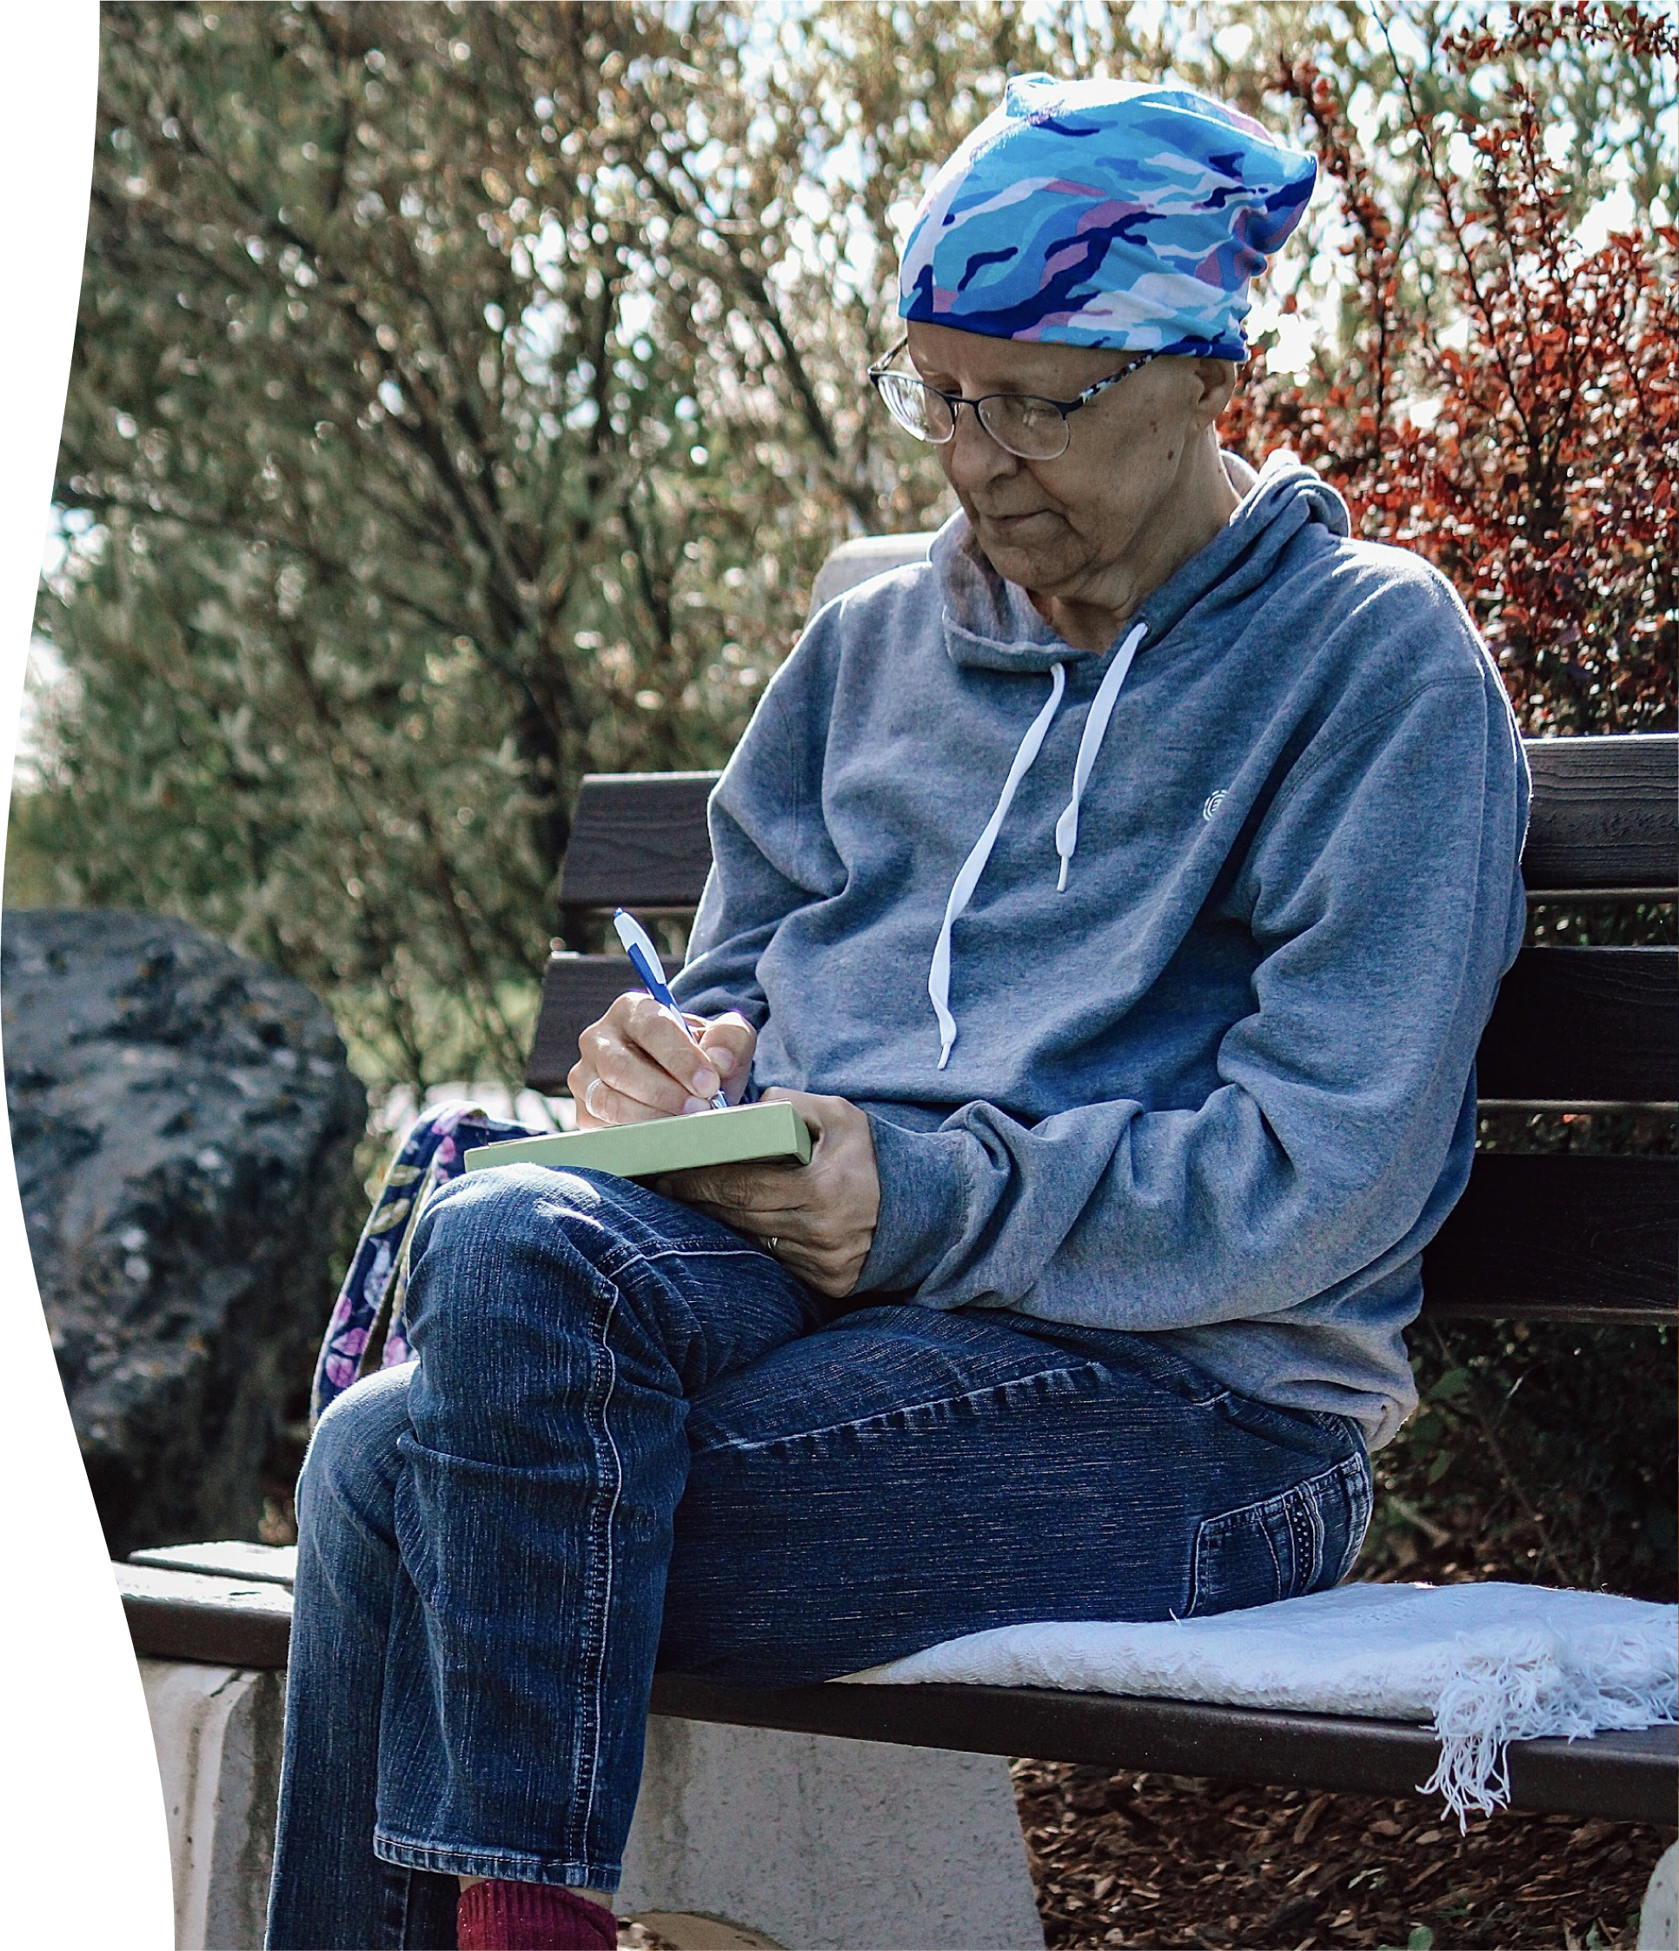
Heading

Slide 7
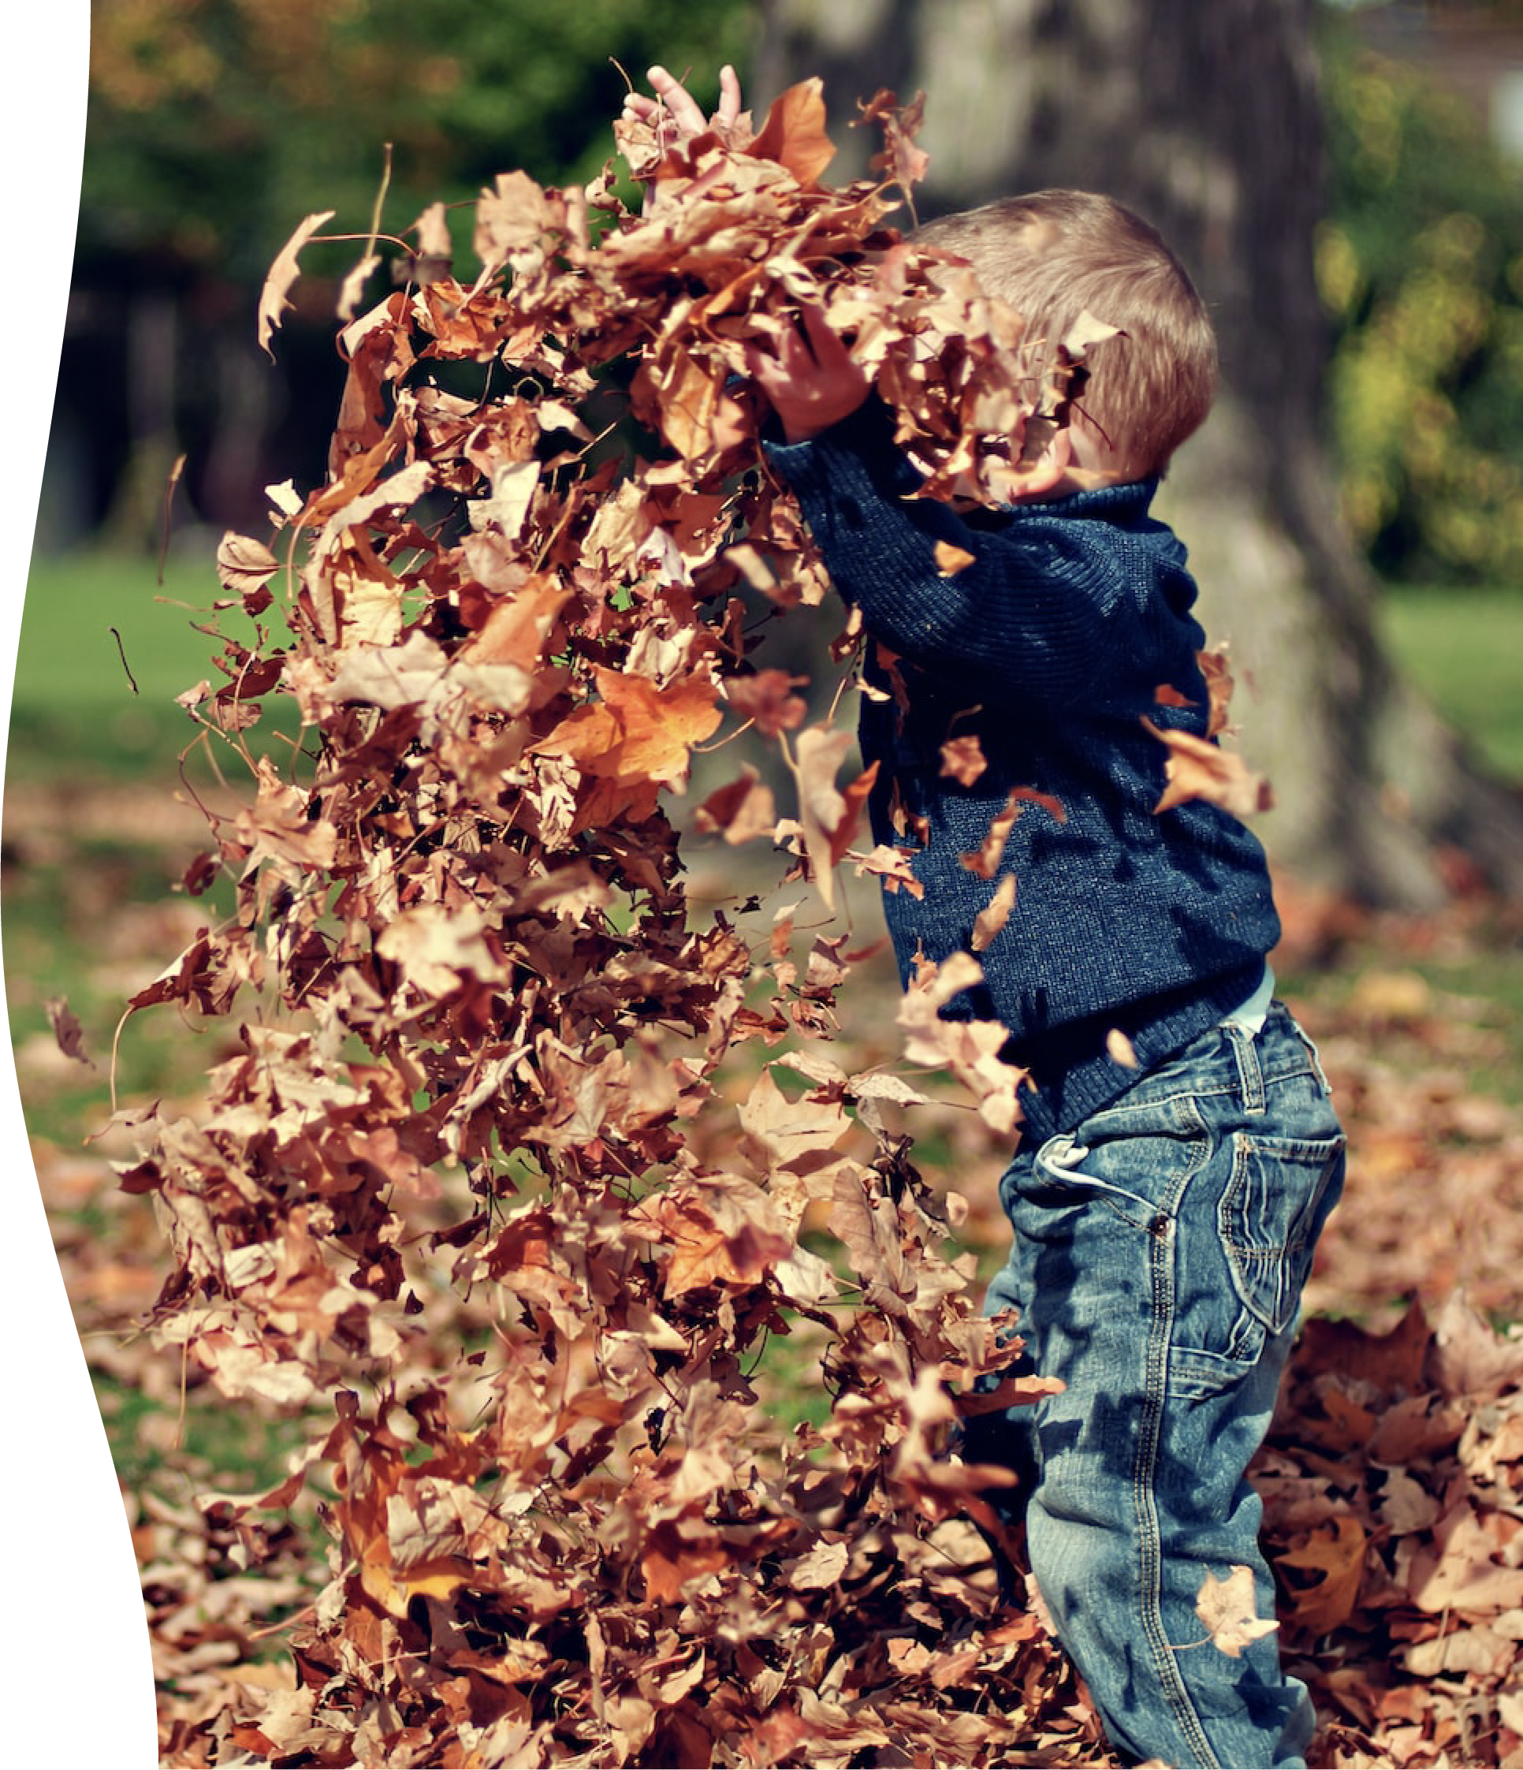
Heading

Slide 8
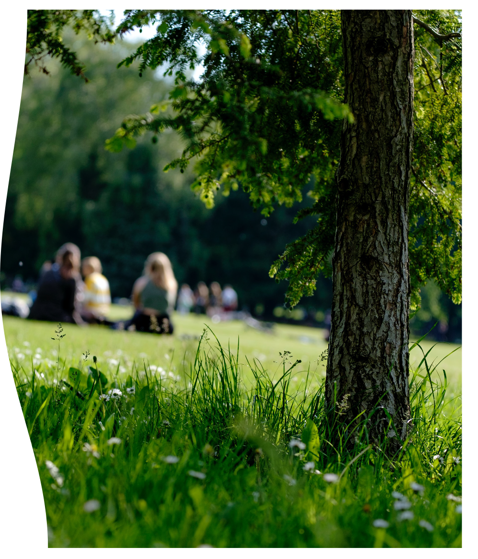
Heading

Slide 9
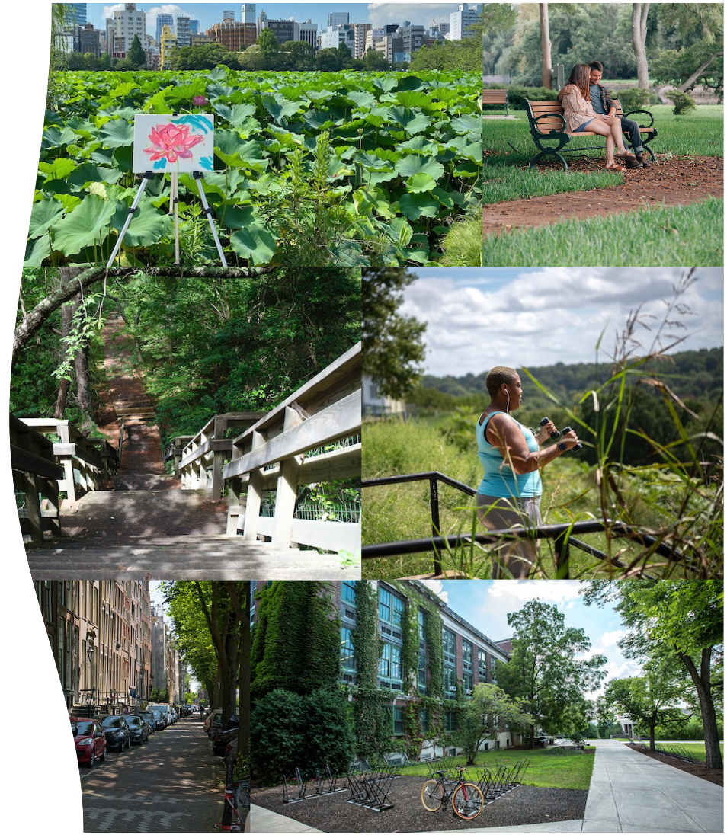
Heading

Slide 10
Heading
Text
Notes:
3:25 – 3:40

Slide 11
Which would most resonate with your community?
Mental Health
Physical Health
Youth and Education
Economic & Environmental Resilience
Social and Community Well-Being

Slide 12

Heading

Slide 13
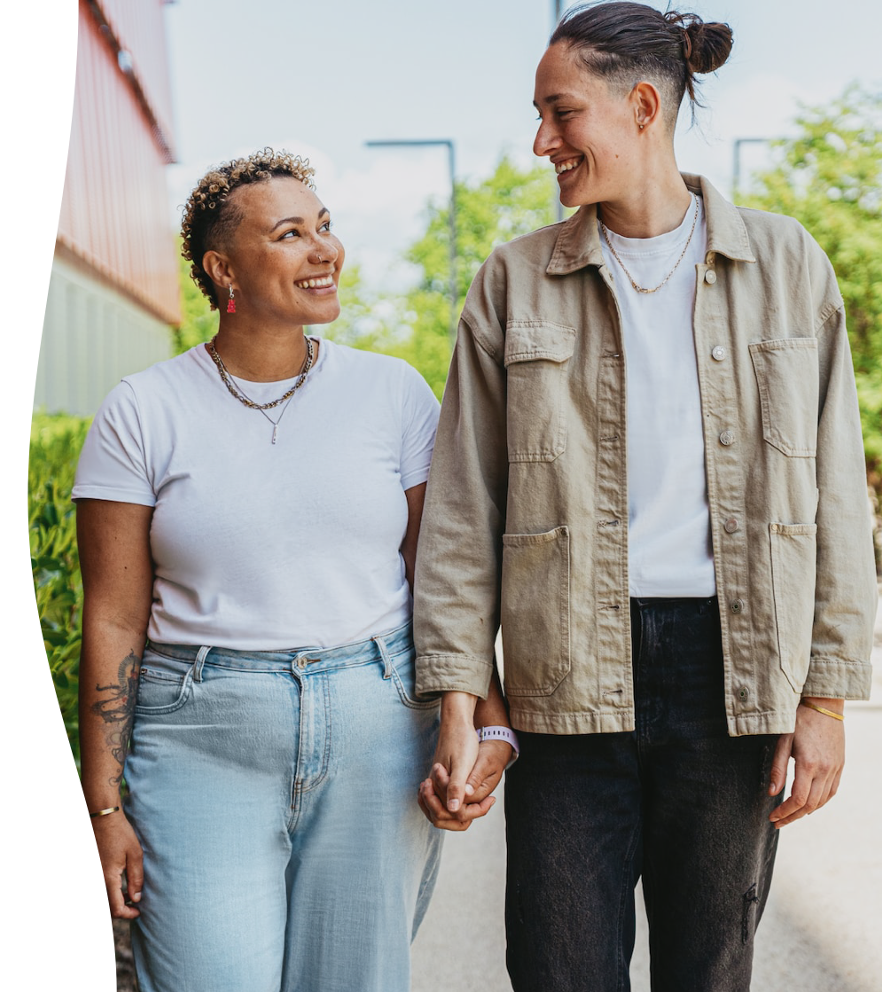
Mental Health Benefits
Associated with:
Increased ability to cope with stress and negative emotions
Reduced risk of anxiety and depression
Effective therapy or treatment for clinical conditions
Thinking benefits: focus, problem-solving, memory and creativity
Notes:
4:20

Slide 14
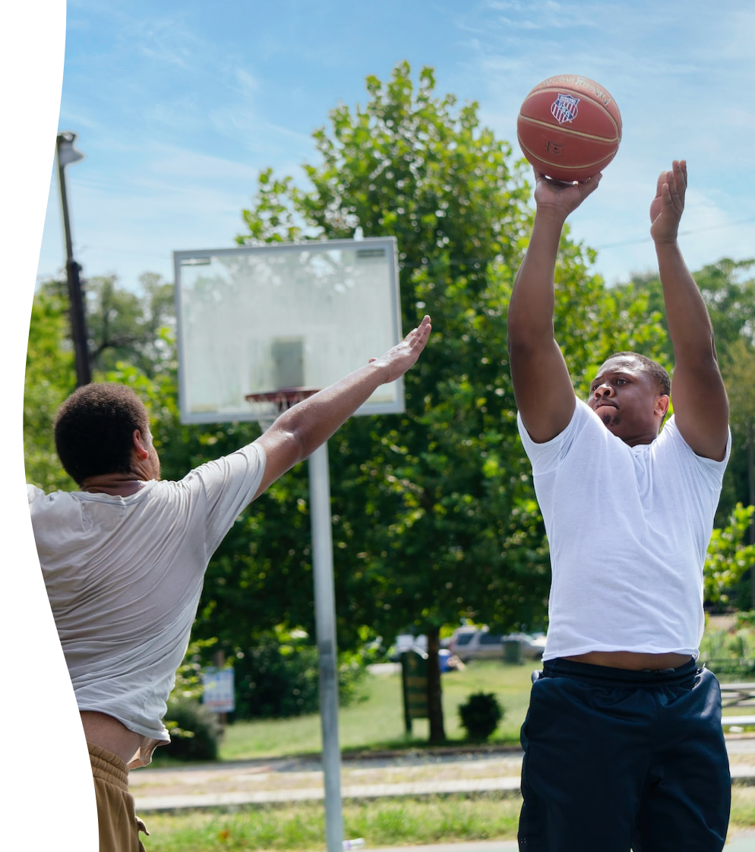
Physical Health
Benefits
Associated with:
Reduced risk of chronic health conditions such as diabetes, heart disease, and cancer
Communities that are more comfortable for moving about, exercising, and being outside
Higher birth weights for babies
Notes:
Associated with living longer

Slide 15
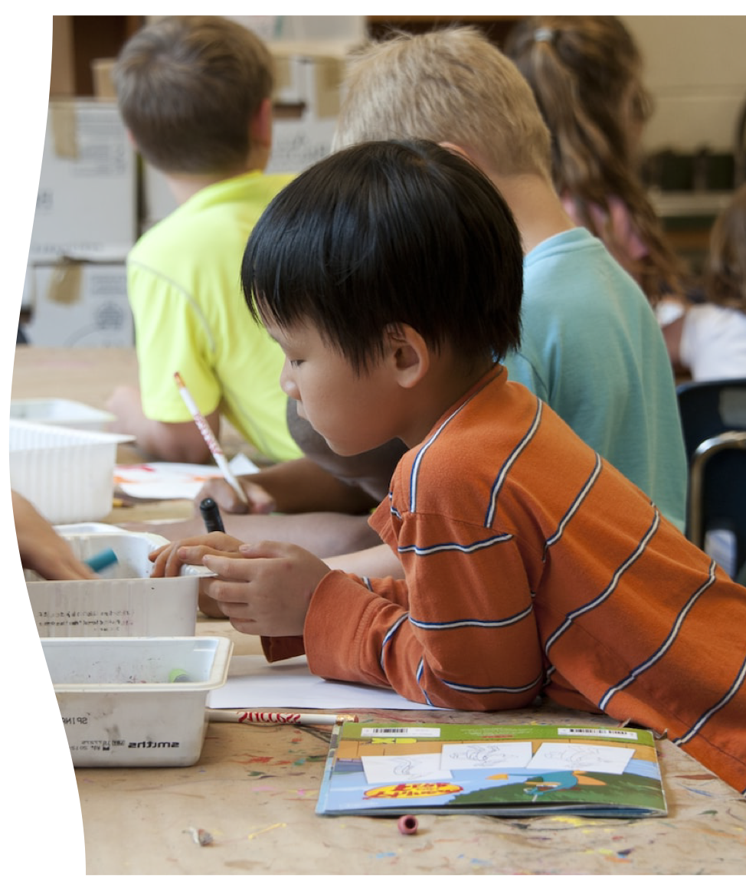
Youth and
Education
Associated with:
Thinking capacity: concentration, quality of focus, memory - school performance, higher grades, goal setting
Emotional well-being and coping: including anger, stress management and self-discipline
Positive impacts on physical and mental health throughout an entire lifetime.

Slide 16
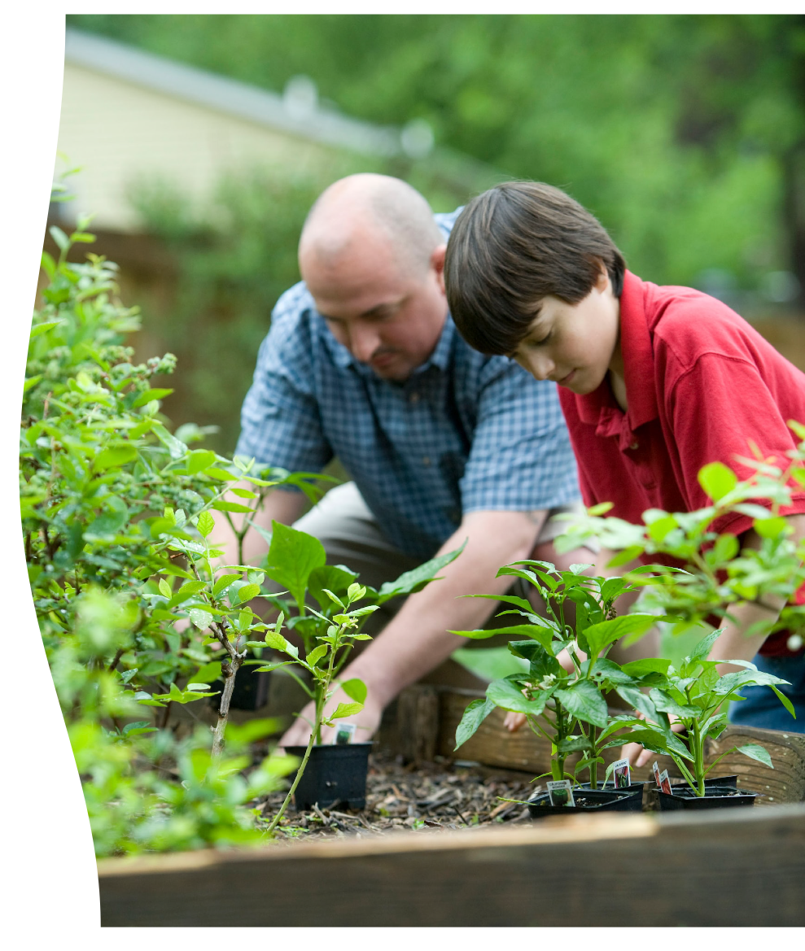
Economic and
Environmental
Resilience
Associated with:
A cooling effect – energy costs
Reduces stormwater pollutants and risk of flooding.
Noise reduction – both the actual decibel level and the perception of noise.
Carbon capture and increased habitat for birds and other species.

Slide 17
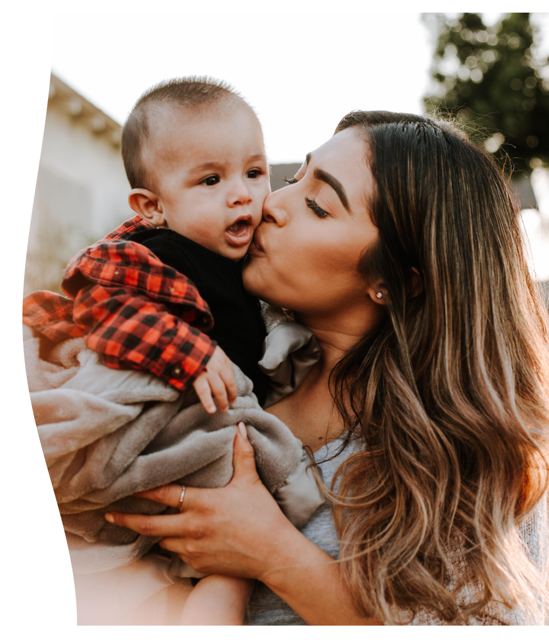
Social and
Community
Well-being
Associated with:
Vital places for facilitating social gatherings—for playing, sharing, bumping into, and networking with others.
More community oriented, cooperative behavior and increased connections to civic life
Defining a sense of place by connecting to the larger histories, stories, and unique cultures that support community building and placemaking.

Slide 18



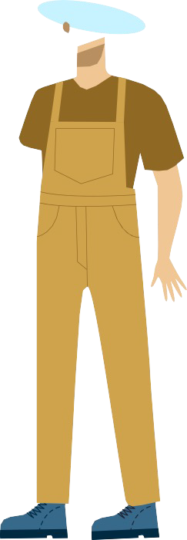
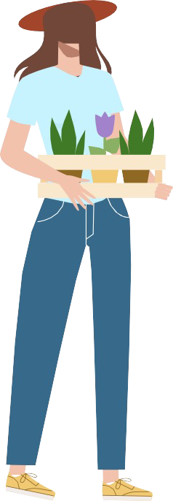









Slide 19
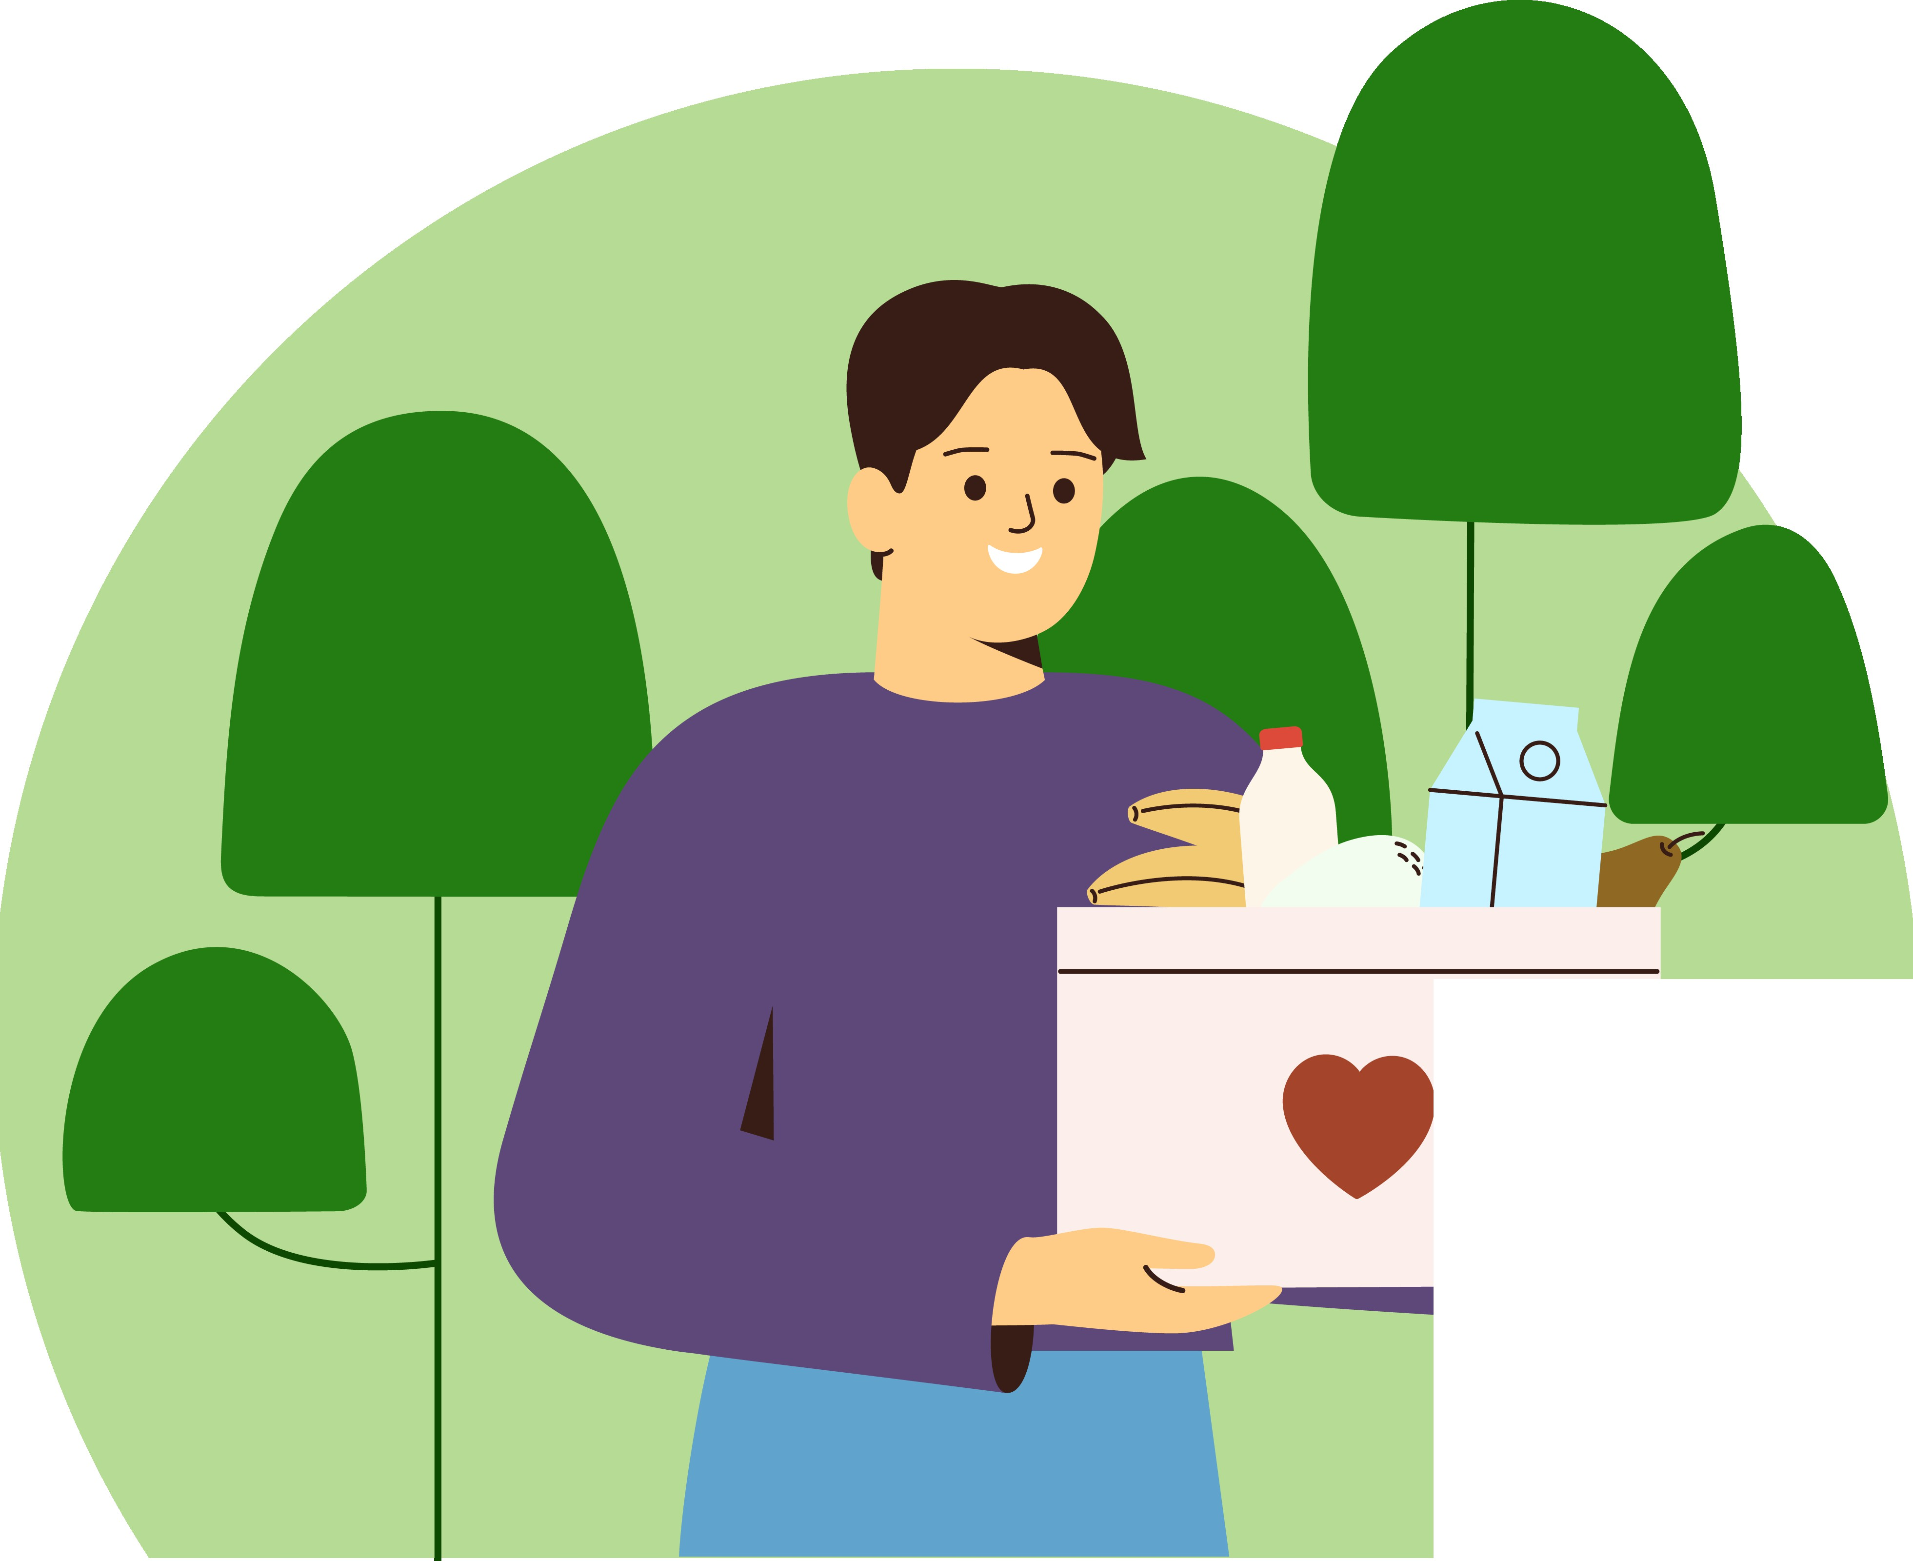

........
........

Slide 20
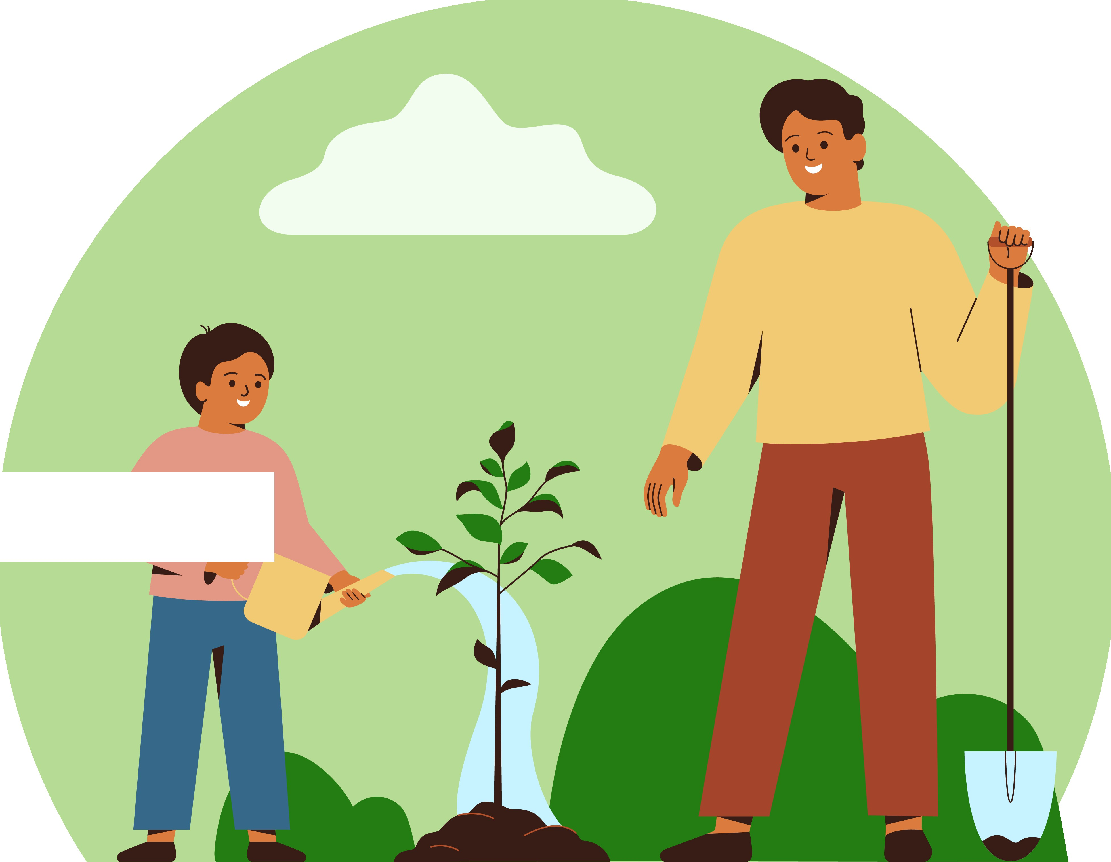
4
\

Slide 21
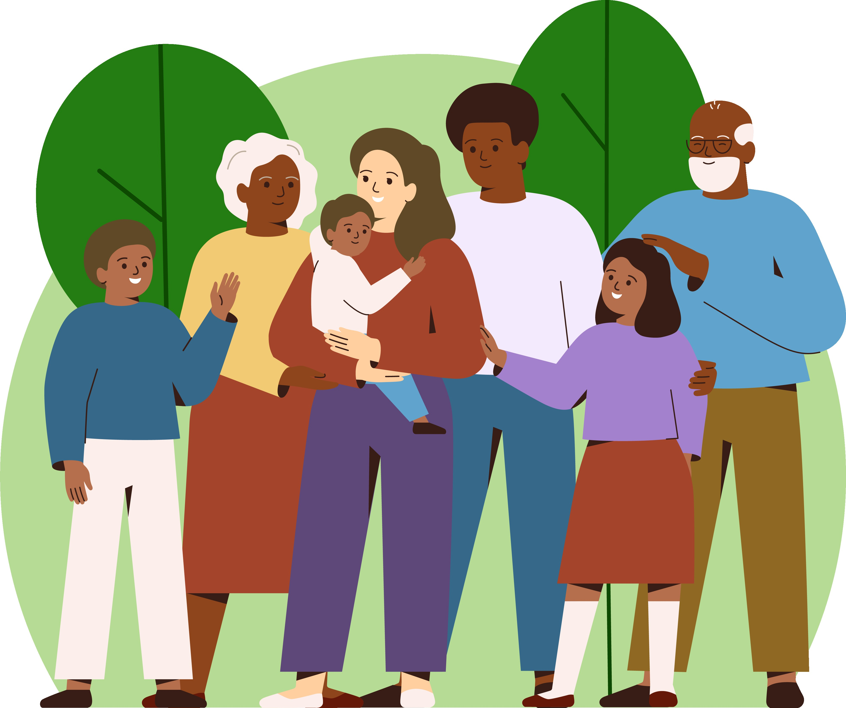

Slide 22


Slide 23
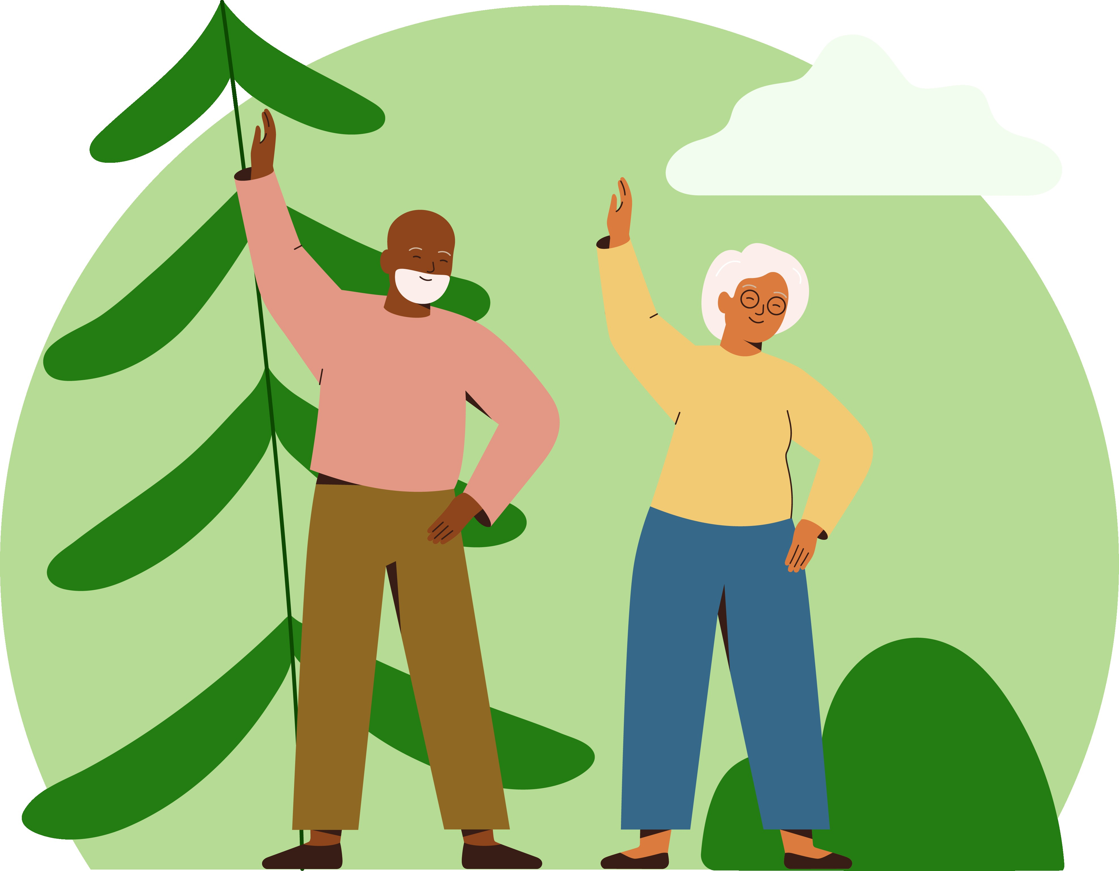

Slide 24
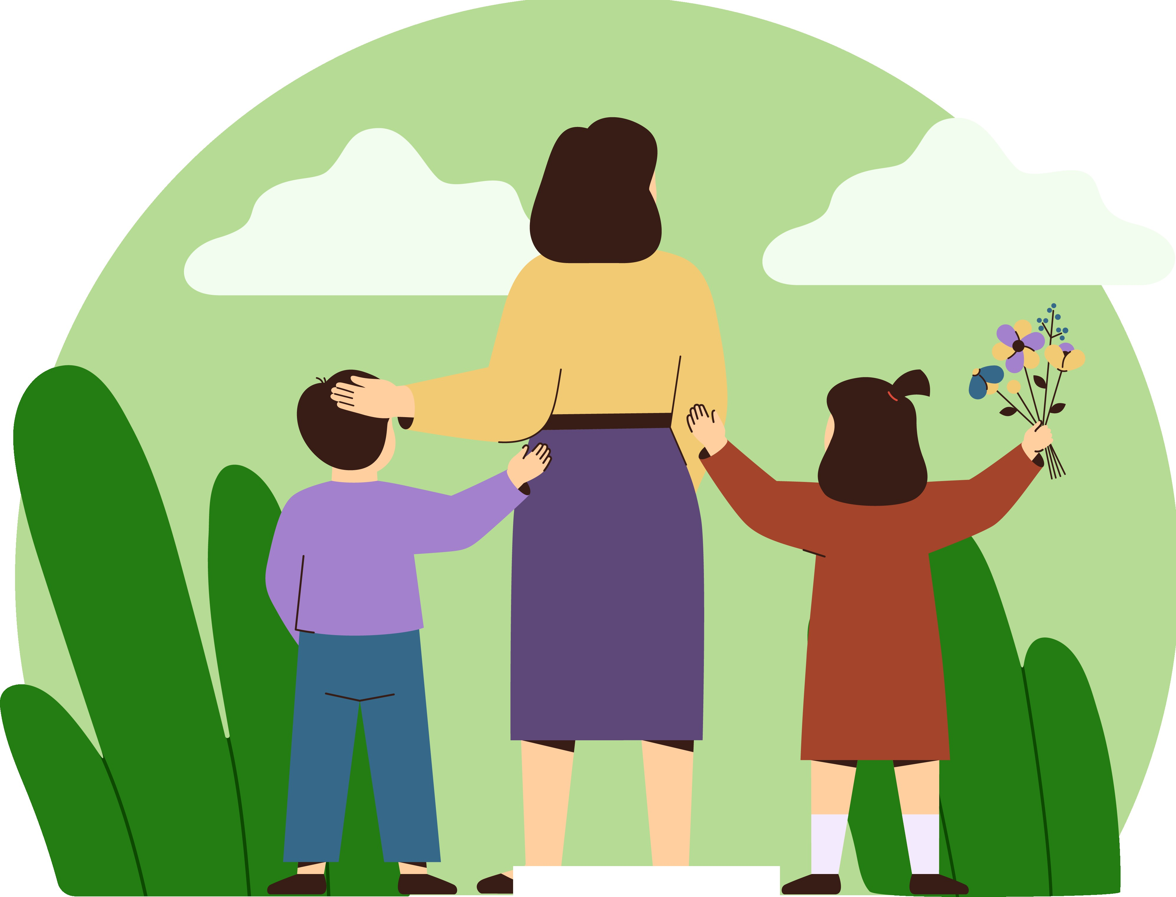
C
-
-

Slide 25


Slide 26



Slide 27
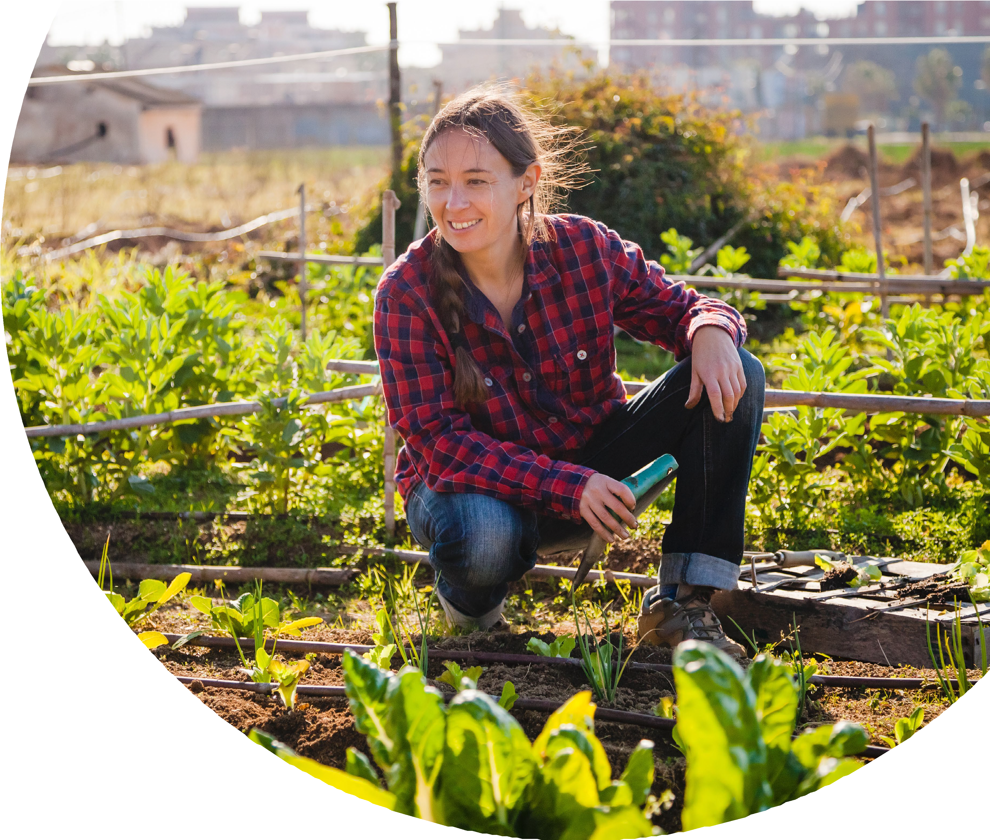

Slide 28
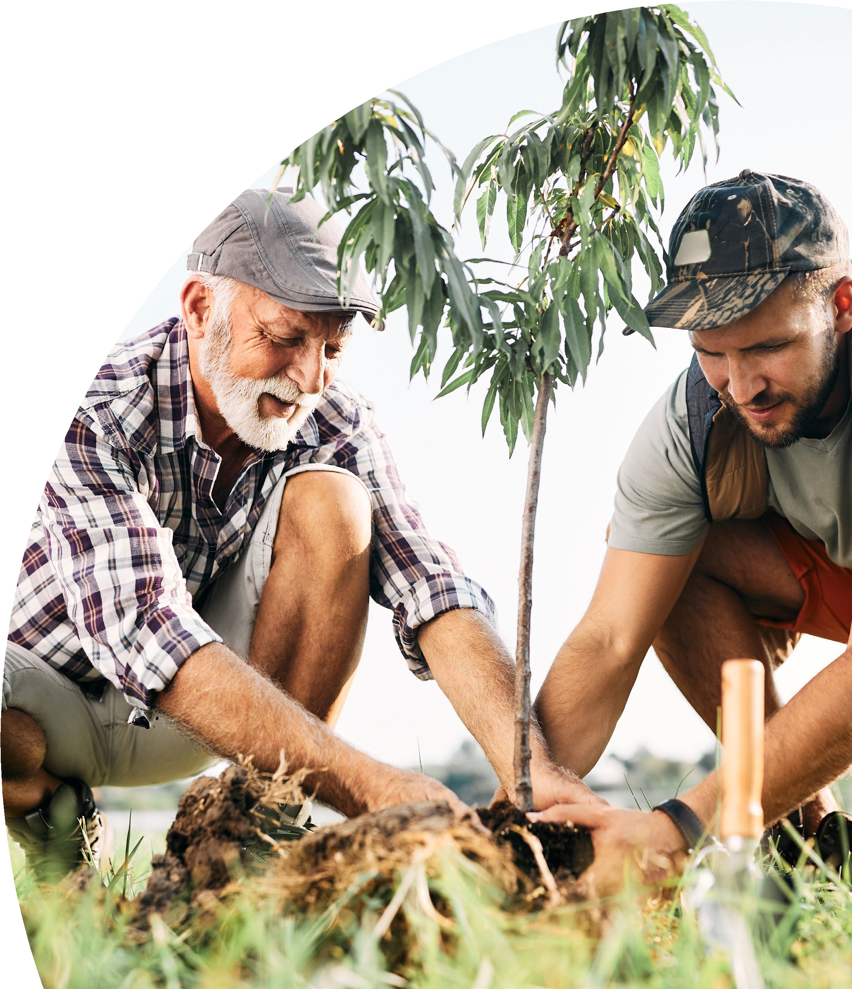

Slide 29


Slide 30

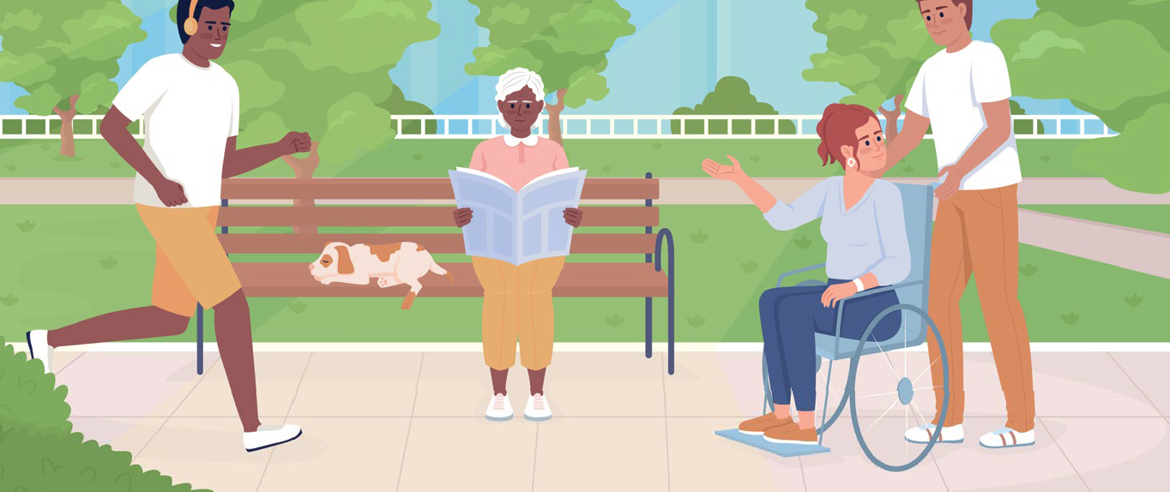

Slide 31
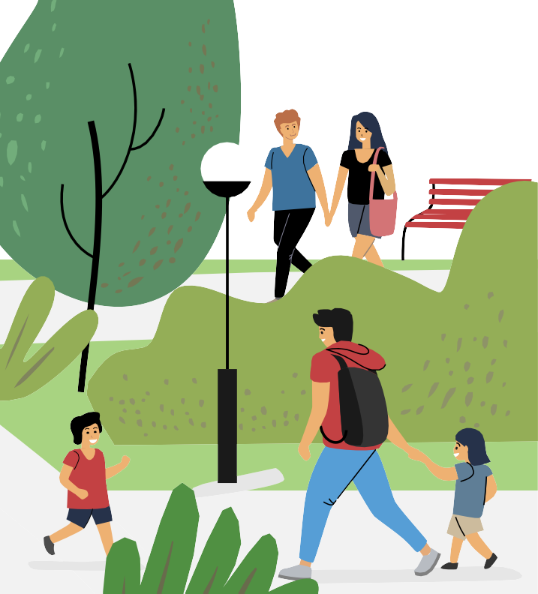

Slide 32


Slide 33
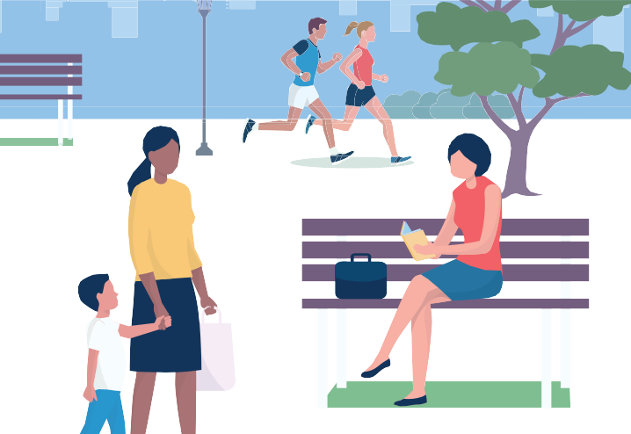

Slide 34


Slide 35
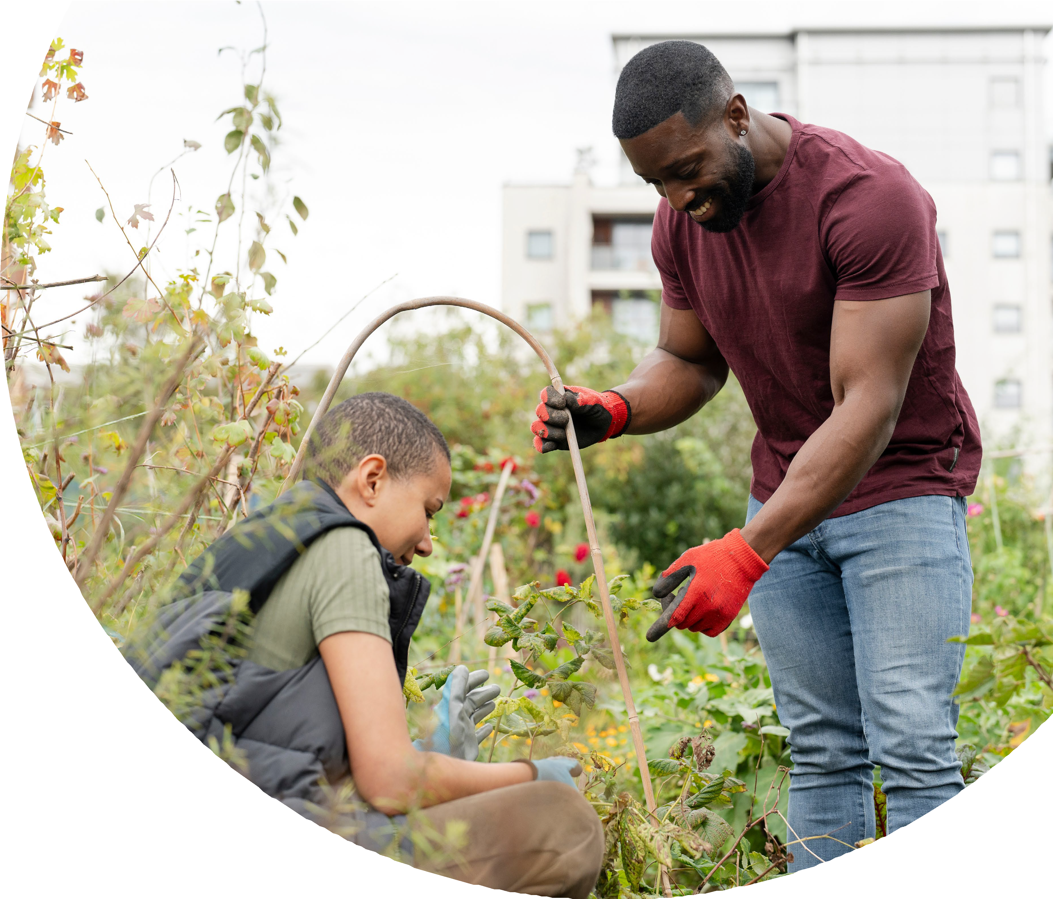

Slide 36
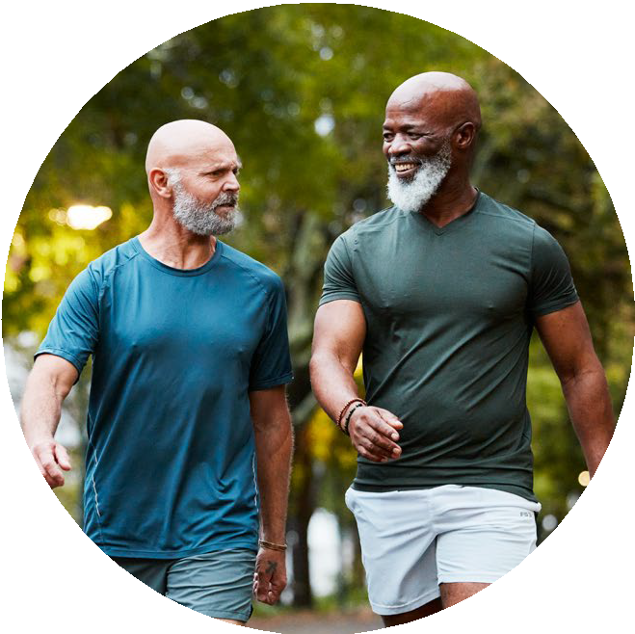

Slide 37
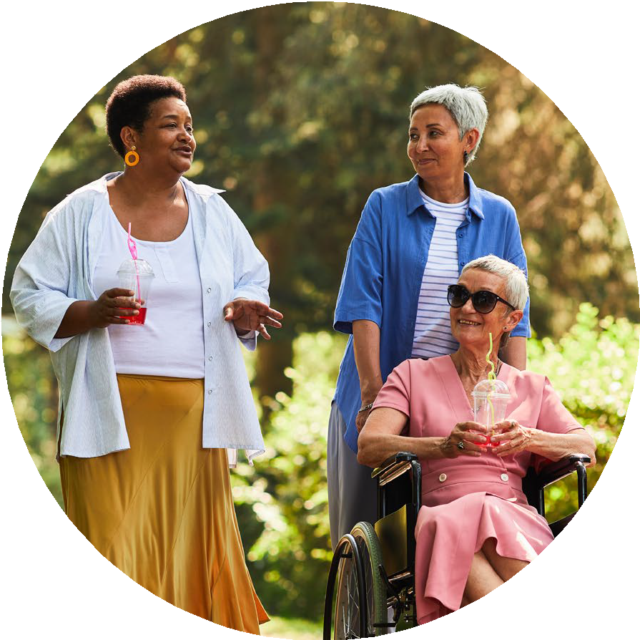

Slide 38


