Slide 1
Project Overview

Slide 2
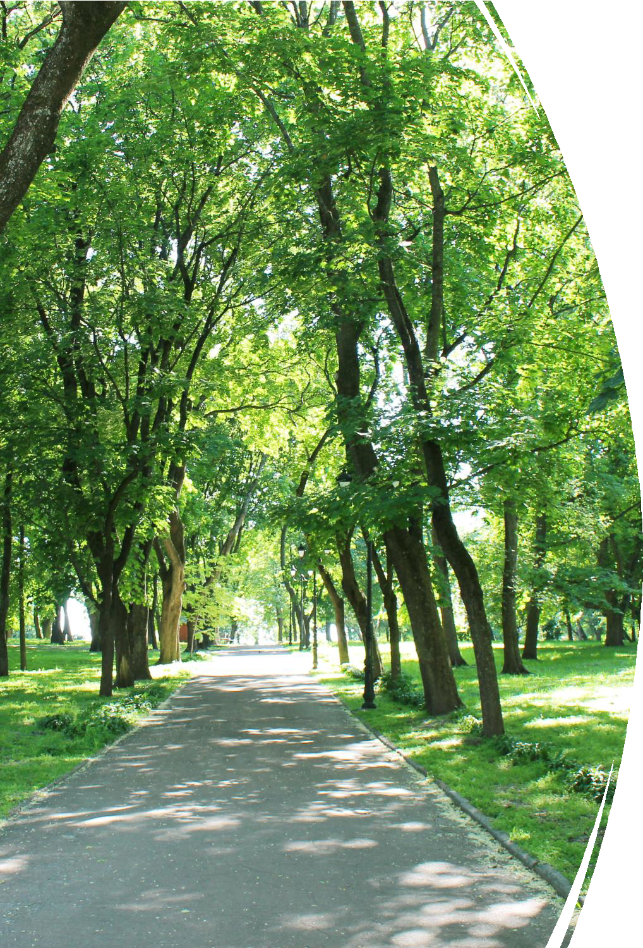
Copy placeholder

Slide 3
Copy placeholder
Copy placeholder

Slide 4
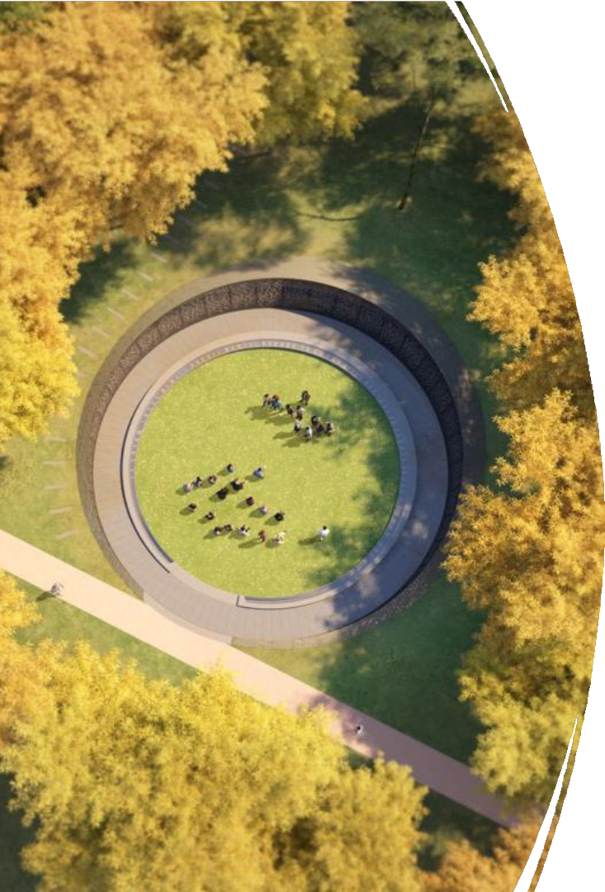
Copy placeholder
Copy placeholder

Slide 5
Copy placeholder
Copy placeholder

Slide 6
Copy placeholder
Copy

Slide 7
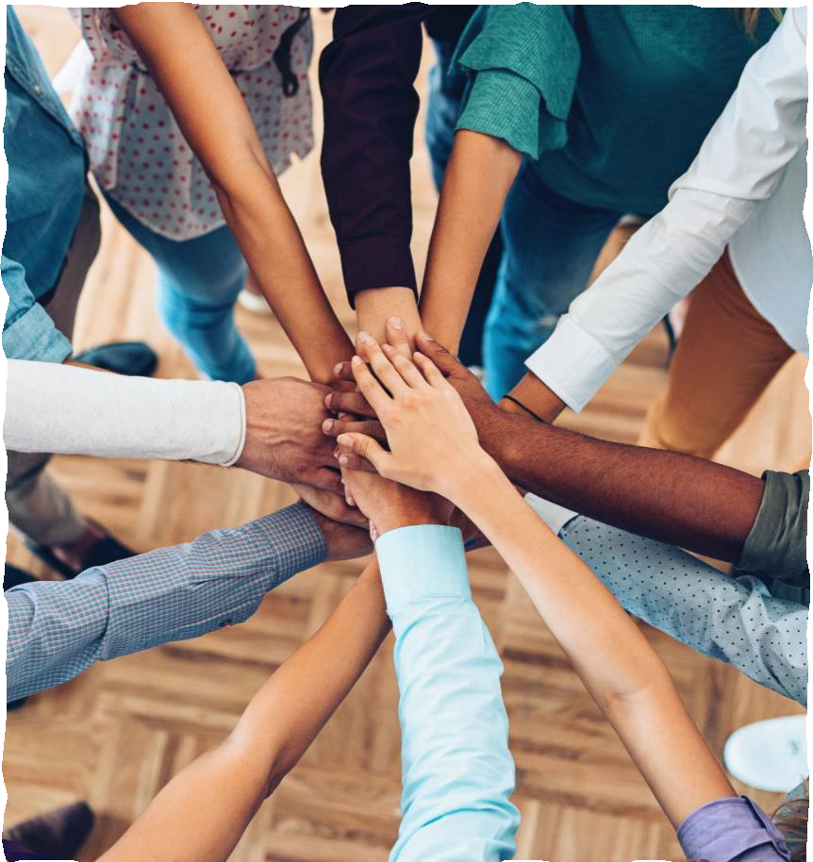
Copy placeholder
Copy placeholder

Slide 8
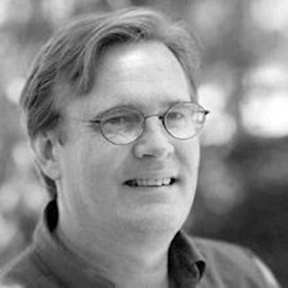
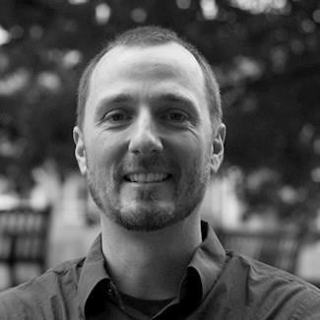
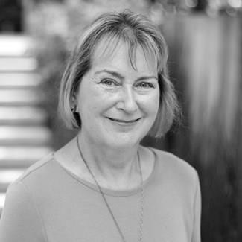
Copy place holder
Replace photos with your own
Tim Beatley, PhD Urban + Environmental Planning
Founder, Biophilic Cities Network
JD Brown Program Director, Biophilic Cities
Jenny Roe, PhD Urban + Environmental Planning
Director, Center for Design + Health

Slide 9
(October 2022 – March 2023)
Phase 1 | Process Design
Copy placeholder
Phase 2 | Develop Messaging Campaigns through Co-Design Process
(March – December 2023)
Phase 3 | Distribution + Testing of Messages
(January – September 2024)
Phase 4 | Develop an Adaptable Messaging Playbook
(September – December 2024)

Slide 10
Copy placeholder
Copy

Slide 11
Copy placeholder – update boxes with own text
Workshop 1
Workshop 2
Workshop 3
Build knowledge and awareness of UCF benefits
Identify/select research and benefits that resonate with the group
Surface + define effective communication methods for demographic groups
Co-design 2-3 messaging concepts
Integrate national priorities where possible
Select and refine one or more messaging concepts
Develop Outreach and engagement strategies for testing of messages

Slide 12
Copy place holder, update below with own text
BOTH ADVISORY TEAMS HAVE BEEN FORMED
WCG LEADING PRESS PACKAGE DEVELOPMENT AND MICROSITE
DRAFT SCHEDULE FOR WORKSHOP AND COHORT ELEMENTS ARE BEING BUILT OUT BY THE PROJECT TEAM
IEN PLANNING AND PREPARING FOR IRB PROTOCOL SUBMISSION
AND CO-DESIGN WORKSHOPS

