Slide 1
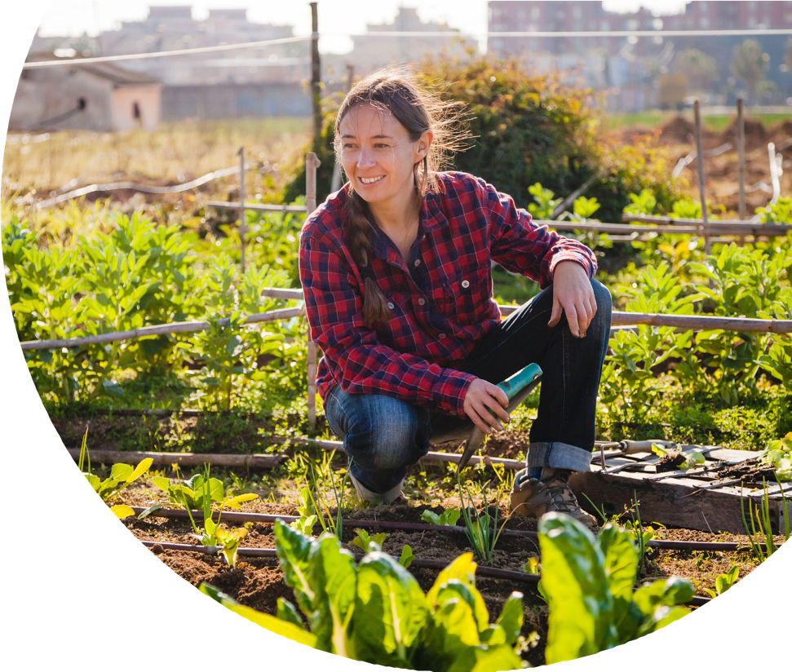
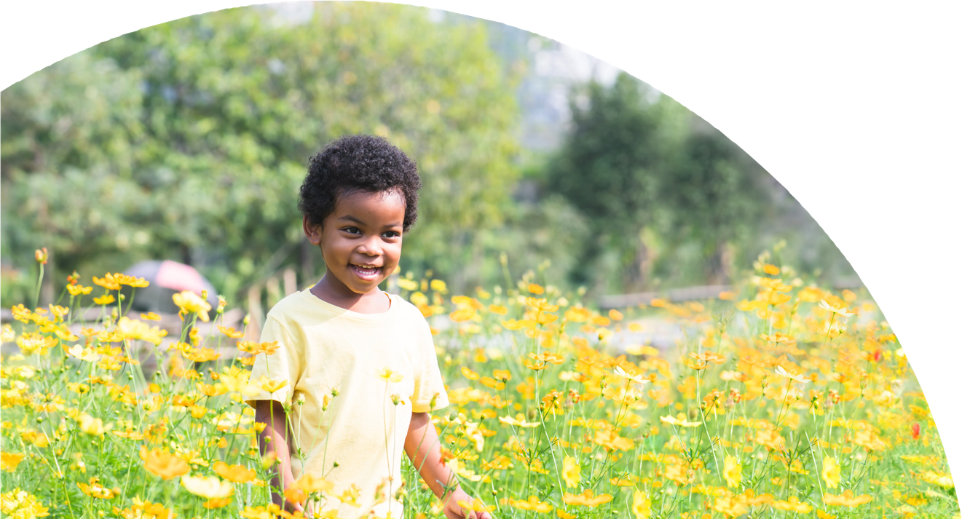
Urban & Community Forestry Toolkit
A guide for communication and outreach to advance green space initiatives in your community
DRAFT
Urban & Community Forestry Toolkit: DRAFT

Slide 2
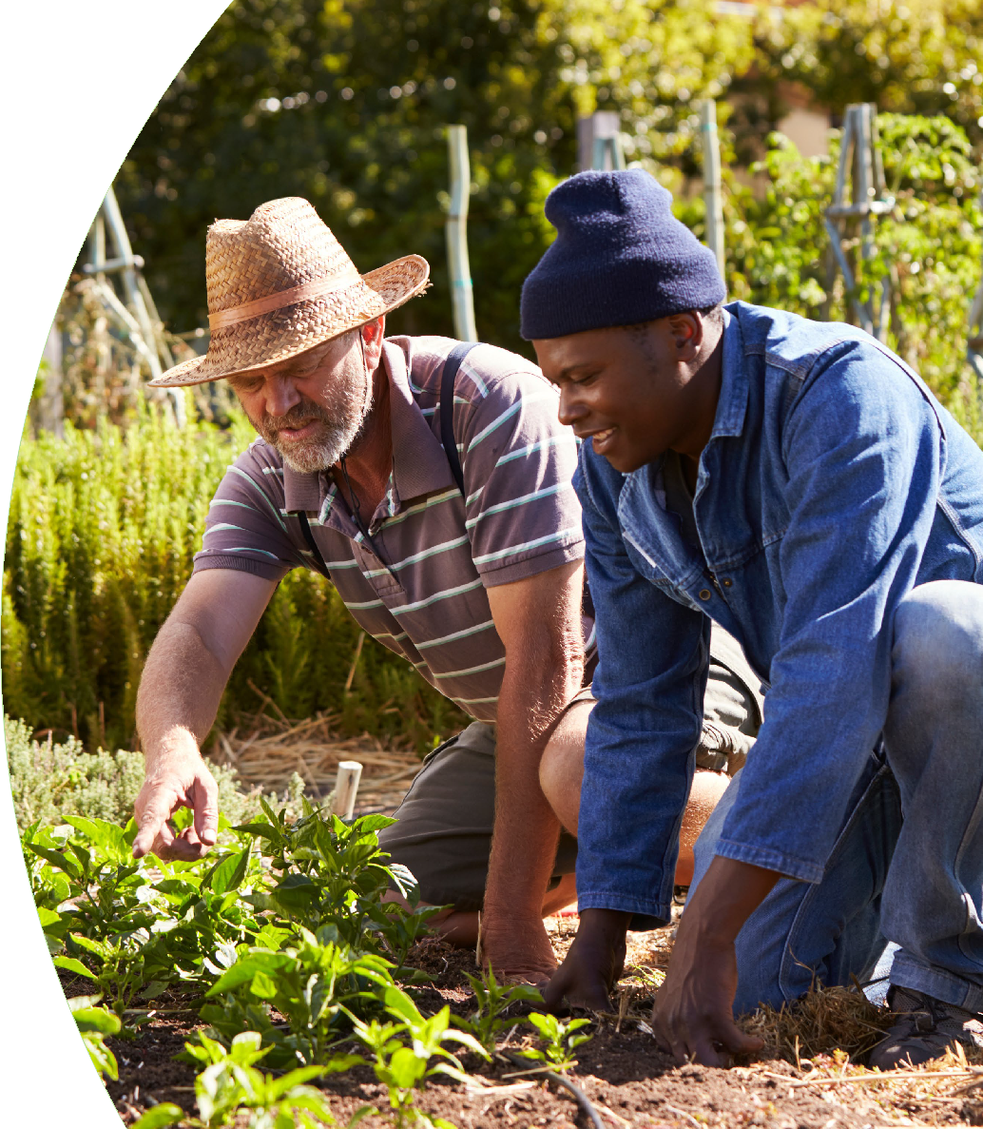
Introduction
Our Purpose
The purpose of this toolkit is to provide resources, information, and guidance to help you best leverage the national Spreading Roots initiative with your local efforts. We want to empower readers with a shared language and standardized approaches to actively engage communities. This guidebook has been carefully designed to provide the foundation for communicating, educating, and conducting outreach to support community efforts in enhancing trees, green spaces, and nature.
To that end, you’ll discover a wide variety of branding elements, documents, scripts, and more that will help you in your goals. Collectively, our voices can start a chorus, and that chorus can ignite a movement.
Our Foundation
This toolkit’s components and language are based on input gathered from collaborative workshops composed of 50 participants who have a history of involvement with under-resourced communities. Attendees—whose homes span the U.S. and its surrounding territories—were either from or collaborated with organizations that focus on equity-related work for seven key demographic groups: Black/African American, Indigenous, Youth, Latine/Latino, Low Income, Vulnerable Populations, and Rural. Participants brought their unique insights and diverse perspectives on communities that are disproportionally impacted by less access to quality trees and green spaces, and are therefore prevented from receiving the significant benefits that nature can bring.
Our Discoveries
During these workshops, we explored what would be most effective in a communications, outreach, and resource toolkit to educate others about the benefits and types of trees, green spaces, and nature, as well as to build support for green initiatives in their communities.
Workshop participants emphasized the importance of community-led projects that considered and honored each community’s history, culture, and lived experiences. This toolkit is centered on understanding their core needs and even hesitancies. This is why it is so important. The resources and tools here can help galvanize grassroots efforts to create healthy and resilient communities through urban and community forestry.
Urban & Community Forestry Toolkit: DRAFT
2

Slide 3
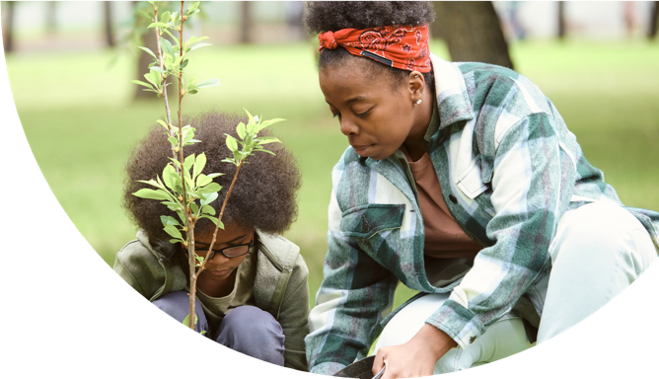
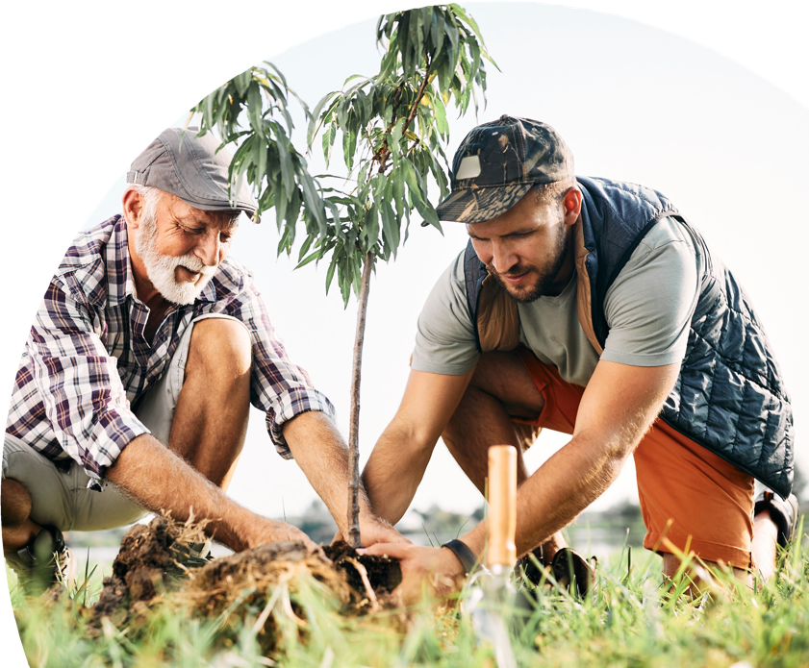
Getting Started
How to Use This Toolkit
Throughout this toolkit you will find various resources and examples of copy and design elements to help you get started in your efforts within your local communities. The examples in this guide are meant to inspire and excite your creativity as you build out your own campaigns. We have provided downloadable templates, broken out by category,
on the Spreading Roots website toolkit page.
Table of Contents
4 Branding & Identity
Program Name Examples
Spreading Roots Logos
Logo Examples
Logo Lockup Examples
Taglines
Mission Statements
Photography & Illustration
Iconography
Public Outreach
15 Flyers & Printed Media
16 Social Media
17 Fact Sheets
20 Infographics
28 Media Scripts
Phone Scripts
Elevator Speeches
PowerPoints
Video Scripts
Where to Find the Tools
Click here to view and download the toolkit and its elements. Please note multiple elements of this toolkit will continue to be built out based on feedback and further exploration over the coming months.
3

Slide 4
Branding & Identity
Program Name Examples
A common program name ensures consistency across materials associated with your initiative, raises visibility, and fosters a clear understanding of your initiative’s goals and purpose.
Here are options related to trees, green spaces, and nature that speak to this initiative’s purpose and goals.
Spreading Roots
Leaf It
CitiBloom
Grow On
Neighborwood Nurtures

Slide 5
Branding & Identity
Spreading Roots Logos
We have provided primary and two secondary, white & black, versions of the Spreading Roots logo. You can also download different file types based on your needs from the Toolkit landing page including .jpeg, .pdf,
.png, and .svg files.
Only use the black logo when color is a restraint in your design (e.g. a black and white print out).
Use the .pdf or .svg files when possible to ensure maximum resolution.

Slide 6
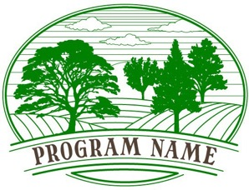
Branding & Identity
Logo Examples
Here are a few additional logo considerations. Feel free to use these as as inspiration when designing your logo and brand identity.
Consider how each communicates a different idea, elicits a different emotion, or speaks to a different aspect of urban and community forestry. Be sure to tailor your logo to fit your organization’s needs.

Slide 7
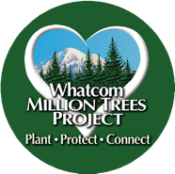
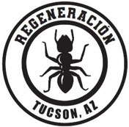
Branding & Identity
Logo Lockup Examples
A logo lockup combines and presents different elements of a logo in a specific arrangement for various applications. It typically includes the primary logo along with other essential elements like taglines, icons, or secondary graphics. The main purpose is to make a unified and powerful visual statement while promoting a cohesive identity and enhancing brand recall.
Several workshop participants provided their logos for these renderings, demonstrating how they can
successfully pair with the Spreading Roots logo. When creating logo lockups, consider developing vertical and horizontal options to accommodate different design needs.

Slide 8
Branding & Identity
Taglines
A well-crafted tagline can serve as a powerful communication tool, fostering community engagement, conveying purpose, and creating a memorable identity that resonates with stakeholders and the broader community.
Here are options for an urban and community forestry initiative that speak to the multiple benefits of preserving, protecting, and growing trees, green spaces, and nature.
Mental Health
Cultivating balance. Sowing seeds of serenity.
Youth & Education
Nurturing the future today.
Empowering youth, enriching communities.
Physical Health
Growing green, growing strong. Actively improving our community.
Universal
Every tree tells our story.
Planting the seeds of change together. Our forests, our future.
Digging in for brighter tomorrows.
Community Well-Being
Branching out together. Growing natural connections.
Rural
Where trees thrive, towns flourish.
Economic & Ecological Resilience
Sustained by nature.
Cultivating a more resilient future.
Urban
City canopy, community roots.

Slide 9
Branding & Identity
Mental Health
To plant the seeds of healing and hope, so our communities can grow into more vibrant, inclusive, and mentally resilient places.
Mission Statements
A mission statement serves as a foundational element for your initiative, providing direction, inspiration, and a shared sense of purpose that is essential for sustained success and positive impact in the community.
When crafting, it may be helpful to segment according to benefits, determine which one resonates most with your community, and develop ideas from there.
Physical Health: the overall well-being of an individual’s body and its proper functioning.
Mental Health: a person’s emotional, psychological, and social well-being.
Community Well-Being: the overall health, happiness, and prosperity of a community or a group of people living in a particular geographic area.
Economic & Ecological Resilience: a system’s ability to withstand and recover from economic shocks,
disruptions, or stressors and an ecosystem’s capacity to absorb disturbances, adapt to change, reorganize, and restore itself
Youth & Education: shaping the future, fostering personal growth, and contributing to the well-being of families, communities, and society
For guidance, here are several options that again speak to the primary benefits of promoting and protecting trees, green spaces, and nature.
Physical Health
To champion the value of urban trees and green spaces as invaluable parts to active and thriving urban communities.
Community Well-Being
To create a sense of belonging, joy, and hope by growing green spaces that are cherished by a more connected and engaged community.
Economic & Ecological Resilience
To grow communities that thrive in balance with nature and prosper through sustainable practices, so that we can build a better future for ourselves and our planet.
Youth & Education
To inspire, educate, and empower young people through the wonders of urban forestry so that they will be more connected to our community today and become the environmental stewards of tomorrow.
National
To foster sustainable and vibrant urban ecosystems and create resilient and inclusive green spaces where the benefits of trees and nature are accessible to all.
National
To foster the growth and preservation of our natural spaces while actively engaging and empowering every member of our community.

Slide 10
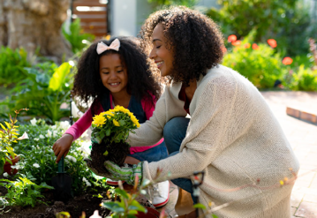
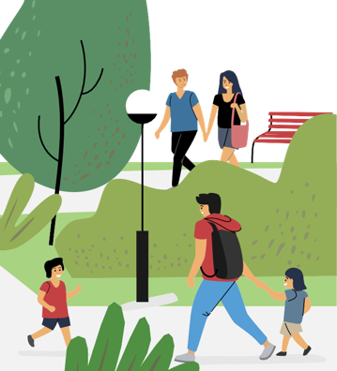
Branding & Identity
Photography & Illustration
Graphic design plays a crucial role in advancing your initiative by visually communicating key messages, enhancing brand recognition, and attracting diverse audiences. Here we provide inclusive illustrative and photographic representations of people engaging with nature in ways that resonate with a wide range of needs and values.
Illustration and photography are available for licensing from various online vendors. Below are a few websites that offer free and/or paid imagery.
Paid
iStock
Getty Images
Adobe Stock
Dreamstime
Shutterstock
Alamy
Free
Pexels
Unsplash
Pixabay
Nappy
Freepik
Noun Project
Some free stock illustrations and photographs require attributing the source. Each vendor’s terms and conditions should be understood before usage.
As a best practice, do not combine illustrations and photography in one marketing piece. Choose one or the other. While photography speaks best to audiences on a personal, more relatable level, illustration is great for conveying concepts and ideas from a more general perspective.

Slide 11
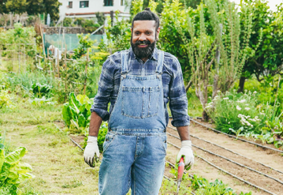
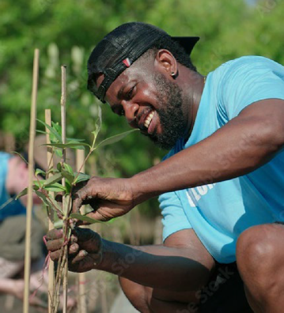
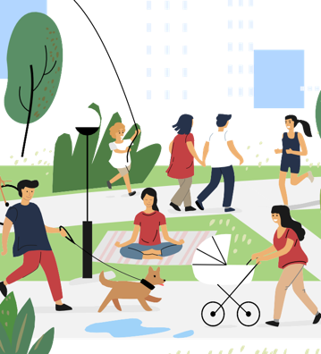
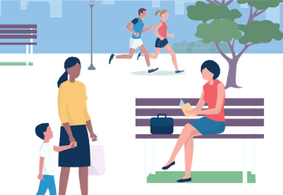
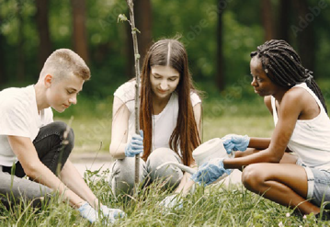
Photography & Illustration
Urban & Community Forestry Toolkit: DRAFT

Slide 12
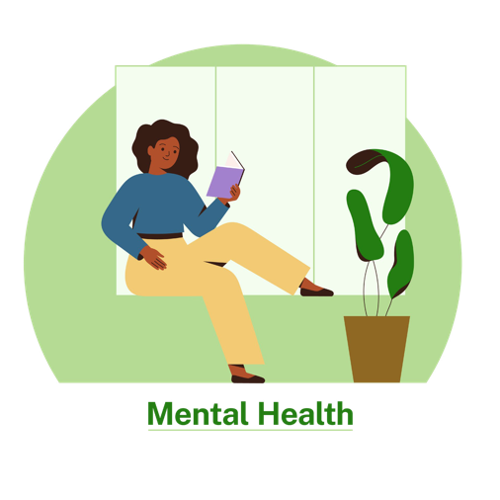
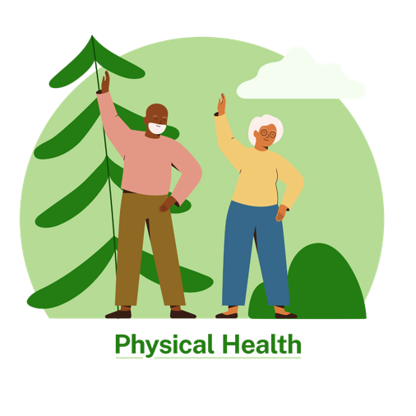
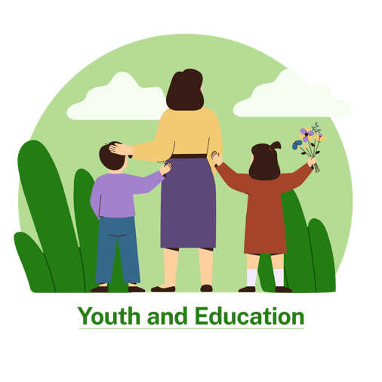
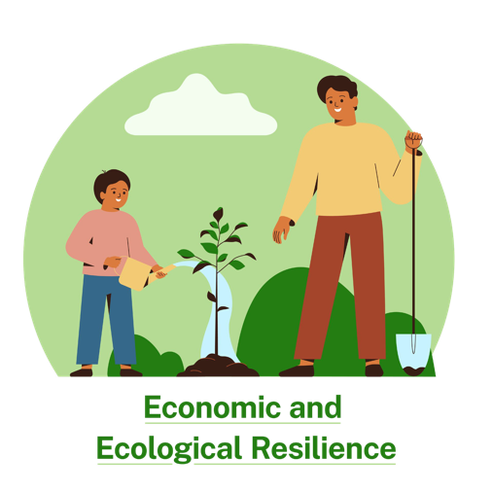
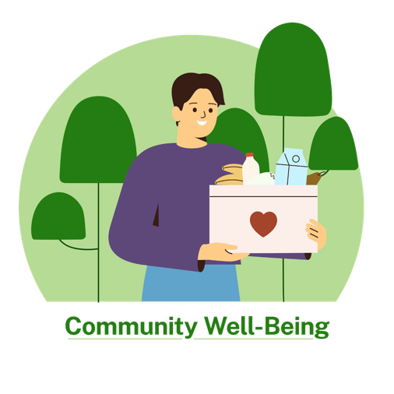
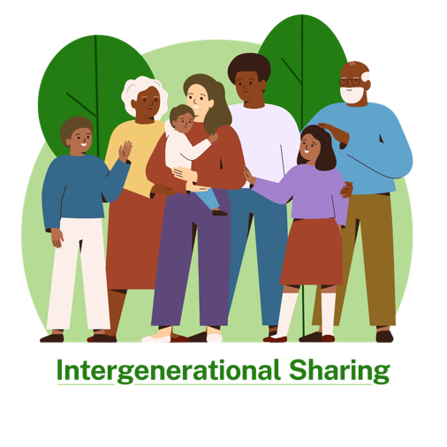
Photography & Illustration
Urban & Community Forestry Toolkit: DRAFT

Slide 13
Photography & Illustration
Mental Health
Physical Health
Youth and Education
Economic and Ecological Resilience
Community Well-Being
Urban & Community Forestry Toolkit: DRAFT

Slide 14
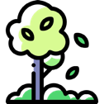
Branding & Identity
Iconography
Icons are an excellent way to provide a bit of visual context or interest to bullet points and blocks of information. When using multiple icons in one piece of collateral, try to use icons of the same style and visual weight. This will help your design remain consistent, clean, and easily digestible.
Below are a few sources for free icon downloads.
Noun Project
Freepik
Flaticon
Some free stock icons require attributing the source. Each vendor’s terms and conditions should be understood before usage.
The icons above are from Noun Project.
The icons above are from Freepik.

Slide 15
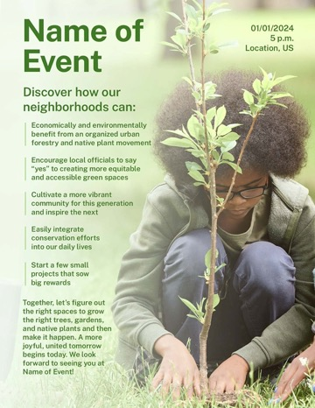
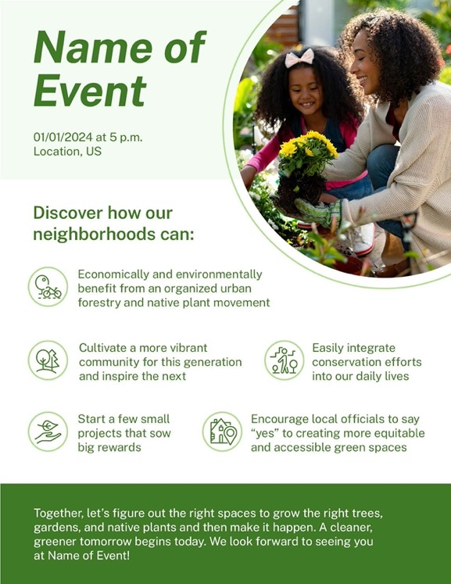
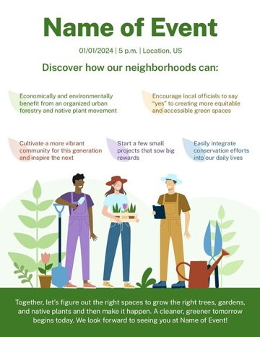
Public Outreach
Flyers & Printed Media
Flyers and posters are vital components that support urban and community forestry initiatives. They effectively communicate key messages, promote events, and engage the community. The templates shown here each use a different graphic element to determine which resonates most with the largest population.

Slide 16
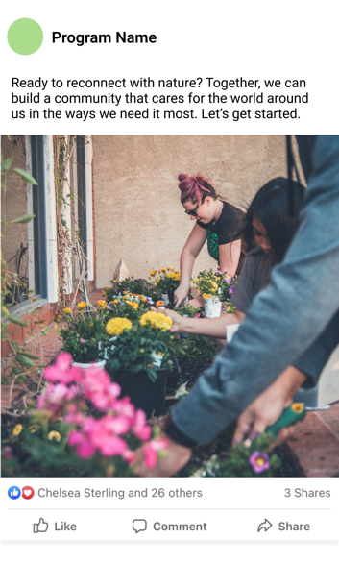
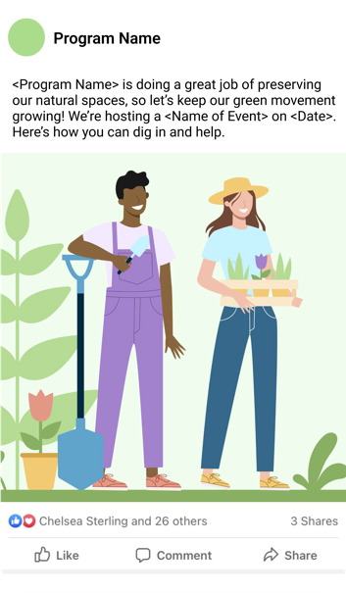
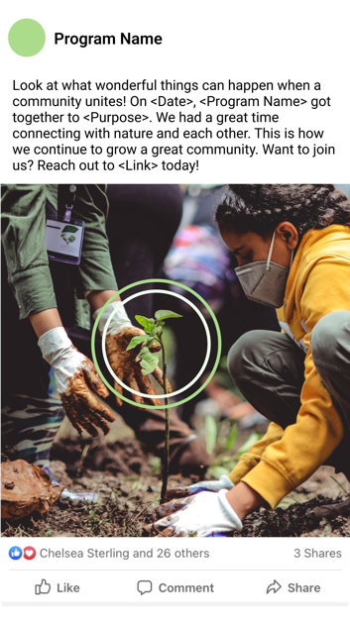
Public Outreach
Social Media
Social media posts can be instrumental in advancing an urban and community forestry initiative by leveraging the reach and engagement potential of online platforms. They foster two-way communication by encouraging questions and discussions and can also get your community more involved. Perhaps best of all, social media analytics can help track post reach, engagement, and audience demographics, providing you with valuable insights for refining your initiative’s strategy.
The options shown here promote an organization, participation in an event, and the results of an event. Each uses a different graphic element to see what best connects with audiences.
For best practices, HubSpot provides a handy Social Media Marketing Guide.

Slide 17
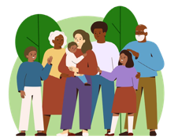
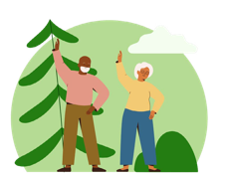
Public Outreach
Info Sheets
Quantifiable data provides a compelling narrative that can effectively persuade group members, policymakers, and the community at large about the tangible benefits of urban and community forestry.
Here we provide solid facts and figures – backed by scientific evidence and supported by references – about how green spaces can improve community wellbeing and benefit the environment. Further, we
offer information about the numerous advantages of food forests. With these info sheets, nature advocates can make a persuasive case for the critical role of green spaces in creating a more sustainable, healthy, and thriving world.
Community Well-Being
Spring 2024
Overview
Urban green space provides vital places for facilitating impromptu and organized social gatherings— spaces for playing, sharing, bumping into, and networking with others. This in turn is associated
with reduced loneliness, improved social cohesion, a greater sense of trust in a neighborhood, a greater sense of place belonging to society, and prosocial behavior (caring for others). Strong social connections have been linked to improved health and well-being, including lower rates of depression and anxiety and higher levels of happiness and life satisfaction.
Community Well-Being
Place-making and Time
Trees, green spaces, and nature enhance the quality of living space and the distinctness of the places we live in. Many cities use this in their official mottos – Raliegh, North Carolin is the City of Oaks and Atlanta is the city in a Forest of Trees (Beatley, 2023).
Older trees connect generations and history. You can be next to larger older trees and know that generations of others have also been there (Beatley, 2023).
Turning vacant spaces (lots etc.) into vibrant places that reflect a community’s aesthetic and cultural values and strengths advance community centered revitalization. These efforts create a sense of community, pride, and ownership among residents. (“How Creative Placemaking Transforms Vacant Properties into Vibrant Community Spaces.,” 2023).
Interesting Information
Connection and Civic Engagement
A number of studies have shown that in the presence of nature we are more likely to be generous, cooperative, and to exhibit positive attitudes and behavior. Communities where residents are immersed in trees and nature may be kinder and more compassionate (Piff et al., 2015).
Participants in tree planting campaigns often engage in broader civic activities, reinforcing democratic values and community bonds (Fisher et al., 2015).
Tree planting in Portland, Oregon was found to be associated with increased voter turnout in primary and general elections (Donovan, 2022).
Cleaning up vacant lots, restoring parks, and creating community gardens are often markers of community resilience.
Safety and Peace
Neighborhoods with homes fronted with street trees experience lower crime rates, according to a study conducted in Portland, Oregon. The same statistic holds true for homes with large yard
trees. These results hold for total-crime rates and specific property crimes such as vandalism and burglary (Donovan, 2010).
A recent study in Philadelphia (Dengler, 2018) showed that transforming vacant lots in neighborhoods below the poverty line into parklike spaces or sprucing up them up with trash removal and mowing reduced overall crime by more than 13% and gun violence by 30%. Burglary and nuisance reports also plummeted in these neighborhoods by nearly 22% and 30%. Residents also used the spaces to relax and socialize 76% more than inhabitants near unmodified lots.
Family
Green spaces can promote multi-generational social interaction. They can provide a place for older adults to engage in physical activity and socialize with others, which can help to combat feelings of loneliness and depression (Urban Forestry Toolkit, n.d.).
Green space is associated with greater longevity in older people, and this is likely connected to the
increased social interaction that is often associated with outdoor time for elderly individuals. They also provide places for parents and children to engage in outdoor activities and spend time together (Urban Forestry Toolkit, n.d.).
Safety and Peace
Community gardens allow for the creation of social ties and build a greater feeling of community. These connections help reduce crime, empower residents, and allow residents to feel safe in their neighborhoods (Munro, 2013).
A community gardening program can reduce food insecurity, improve dietary intake, and strengthen family relationships. (Carney et al., 2011).
References
Beatley, T. (2023). Canopy Cities: Protecting and expanding urban forests. Routledge.
Carney, P. A., Hamada, J. L., Rdesinski, R. E., Sprager, L., Nichols, K. R., Liu, B. Y., Pelayo, J., Sanchez, M., & Shannon, J. (2011). Impact of a community gardening project on vegetable intake, food security and family relationships: a community-based participatory research study. Journal of Community Health, 37(4), 874–881. https://doi.org/10.1007/s10900-011-9522-z
How creative placemaking transforms vacant properties into vibrant community spaces. (2023, May 18). Community Progress. https://communityprogress.org/blog/revitalizing- neighborhoods-how-creative-placemaking-transforms-vacant-properties-into-vibrant-com
Dengler, R. (2018) Feb. 26. This City fights crime with gardening: Picking up trash and mowing vacant lots makes Philadelphia, Pennsylvania neighborhoods safer. Science.
Donovan, G. H., & Prestemon, J. P. (2010). The effect of trees on crime in Portland, Oregon. Environment and Behavior, 44(1), 3–30. https://doi.org/10.1177/0013916510383238
Donovan, G. H., Prestemon, J. P., Gatziolis, D., Michael, Y. L., Kaminski, A. R., & Dadvand, P. (2022). The association between tree planting and mortality: A natural experiment and cost- benefit analysis. Environment International, 170, 107609. https://doi.org/10.1016/j.envint.2022.107609
Fisher, D. R., Svendsen, E. S., & Connolly, J. J. (2015). Urban environmental stewardship and civic engagement. https://doi.org/10.4324/9781315857589 Munro, K. (2013, July 11). The Many Benefits of Community Gardens. Greenleaf Communities. https://www.greenleafcommunities.org/
Piff, P. K., Dietze, P., Feinberg, M., Stancato, D. M., & Keltner, D. (2015). Awe, the small self, and prosocial behavior. Journal of Personality and Social Psychology, 108(6), 883–899. https://doi. org/10.1037/pspi0000018
Urban Forestry Toolkit. (n.d.). Vibrant Cities Lab: Resources for Urban Forestry, Trees, and Green Infrastructure. https://www.vibrantcitieslab.com/toolkit/

Slide 18
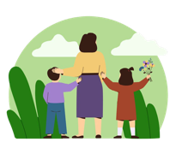
Info Sheets
Environmental Benefits
Spring 2024
Environmental Benefits
Biodiversity and Wildlife Corridors
Trees are foundational to many ecosystems, supporting biodiversity. They provide habitat and food for countless species from canopy to forest floor (Green Canopy, Better World: Exploring the Benefits of Trees, n.d.).
Green spaces create wildlife corridors in cities essential for the survival of urban wildlife. They enable birds and insects to navigate through cities promoting ecological diversity in urban settings. They support biodiversity. Moths, birds, bats, dormice, butterflies, fungi depend on woods, trees and hedges to feed, breed and thrive (Green Canopy, Better World: Exploring the Benefits of Trees, n.d.).
Even small patches of genuinely biodiverse nature can re-invite and sustain multitudes of plant and animal species, as urban ecologists have shown (Why We Need Trees: Trees Help Fight Climate Change, Save Wildlife, and Improve Our Health., n.d.).
Overview
Trees, green spaces, and nature provide crucial environmental benefits to urban areas such as reducing air pollution, addressing heat island effect, providing critical habitat, and mitigating numerous climate change impacts.
Environmental Benefits
Cooling
Cities are generally warmer than surrounding agricultural and forested areas due to the dominance of impervious surfaces and the fact that urban materials absorb and hold heat. This is called the urban heat island effect. Urban forests and green roofs can aid in reducing urban heat island effects (Wolf et al., 2015).
Parks can be up to 2°F cooler than the surrounding urban area in the day. Large numbers of trees and expansive green spaces across a city can reduce local air temperatures by up to 9°F (Wolf et al., 2015).
Low-income neighborhoods have on average 26% less tree cover and are 7ºF hotter. Neighborhoods with the highest concentration of people of color—regardless of income— have on average 38% less tree cover and are 10ºF hotter (Daley, 2023).
Interesting Information
Air Pollution
Trees and vegetation can help reduce air pollution by removing pollutants and reducing air temperature, both of which contribute to smog. They also reduce energy needs for cooling impacting the associated pollutant emissions from power plants.
Trees absorb pollutants like nitrogen oxides, ammonia, sulfur dioxide, and ozone, effectively purifying the air. Leaves also capture dust and smoke particulates (Green Canopy, Better World: Exploring the Benefits of Trees, n.d.).
Air quality benefits significantly impact respiratory illnesses. Nowak (2014) found that trees removed 17.4 million tons of air pollution across the United States, which prevented 850 human deaths and 670,000 cases of acute respiratory symptoms. The human health effects associated with this pollution removal were valued at 6.8 billion dollars (about $21 per person in the US).
17.4M
Tons of air pollution
removed
850
Prevented human deaths
Heat is the leading cause of death from extreme weather
Resources
(EPA) National Stormwater Calculator (http://www2. epa.gov/water-research/national-stormwater-calculator) can be used to estimate annual stormwater runoff, based on site-specific information. Other tools are available from the U.S. Department of Agriculture Forest
Service tool to calculate ecosystem services provided by an urban forest canopy (if-Tree Eco; http:// www.itreetools.org/) or by street trees (i-Tree Streets; http://www.itreetools.org/streets/index.php).
in the United States, with research led by Duke University projecting that climate change could increase this to nearly 100,000 heat-related deaths per year by 2100 (Daley, 2023).
A tree can cool the area underneath it by as much as 45ºF and studies have found trees can reduce cooling load in a home by more than 50% when placed in the right locations (Daley, 2023).
Up to
45ºF
Cooler under tree coverage
Up to
50%
Reduced A/C load
Reduce Green House Gases
Up to 60 billion new trees could be planted by 2040 if suitable land is used without reducing food production. These trees could remove up to 540 million tons of carbon dioxide annually from the atmosphere, equivalent to nearly 10% of the country’s net greenhouse gas emissions (Rudee, 2020).
Approximately 1.83 billion trees are planted globally each year. That’s an impressive effort to restore and expand green spaces. This translates to around 58 trees planted every second (McInerney, 2024).
Trees don’t just mitigate carbon, removing it from the atmosphere, they also sequester it – absorbing carbon dioxide during photosynthesis and then locking it up for centuries. Research has shown that urban trees in the United States sequester some 22.8 million tons of carbon each year (The Morton Arboretum, 2024).
Water Conservation, Quality and Flooding
Tree Planting Statistics - https://www.gotreequotes.com/tree-planting-statistics/
Climate change is impacting the frequency and severity of flooding in our communities. Trees, green spaces, and nature play a vital role in reducing flooding by slowing down the flow of rainwater, absorbing rainwater and reducing erosion before hitting the ground (Why We Need Trees: Trees Help Fight Climate Change, Save Wildlife, and Improve Our Health., n.d.).
Rain hits the ground at higher speeds where there is a lack of tree cover. A canopy of leaves, branches and trunks slows down the rain before it hit the ground and can spread the effect of a rainstorm and in turn allow some of the water to evaporate back into the atmosphere (Why We Need Trees: Trees Help Fight Climate Change, Save Wildlife, and Improve Our Health., n.d.).
Root systems help water penetrate deeper into the soil at a faster rate under and around trees which mean less surface run-off, also preventing erosion (Why We Need Trees: Trees Help Fight Climate Change, Save Wildlife, and Improve Our Health., n.d.).
Impermeable surfaces in urban areas increase run off. Trees reduce surface water run off by 80% compared to asphalt. Trees and soils improve water quality in that they can remove harmful
substances washed off roads, parking lots, and roofs during rain or snow events (Wolf et al., 2015).
The US Forest Service estimates that 100 mature trees intercept about 250,000 gallons of rainfall per year in their leafy crowns (The Morton Arboretum, 2024).
References
Daley, J. (2023, November 17). America is making tree equity a climate solution for cities. TIME.
Green Canopy, Better World: Exploring the benefits of trees. (n.d.). Gardenia - Creating Gardens. https://www.gardenia.net/guide/green-canopy-better-world-benefits-of-trees
Nowak, D. J., Hirabayashi, S., Bodine, A. R., & Greenfield, E. J. (2014). Tree and forest effects on air quality and human health in the United States. Environmental Pollution, 193, 119–129. https://doi.org/10.1016/j.envpol.2014.05.028
McInerney, B. (2024, April 11). Tree planting statistics. GoTreeQuotes. https://www.gotreequotes.com/tree-planting-statistics/
Rudee, A. (2020, February 12). How and where to plant 60 billion trees in the US. World Resources Institute. https://www.wri.org/insights/how-and-where-plant-60-billion-trees-us The Morton Arboretum. (2024, April 12). Benefits of trees | The Morton Arboretum https://mortonarb.org/plant-and-protect/benefits-of-trees/#environment
Why we need trees: Trees help fight climate change, save wildlife, and improve our health. (n.d.). Woodland Trust. Retrieved April 24, 2024, from https://www.woodlandtrust.org.uk/trees- woods-and-wildlife/british-trees/benefits/
Wolf, K. L., & Robbins, A. (2015). Metro Nature, environmental health, and economic value. Environmental Health Perspectives, 123(5), 390–398. https://doi.org/10.1289/ehp.1408216
Urban & Community Forestry Toolkit: DRAFT

Slide 19
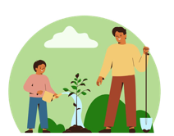
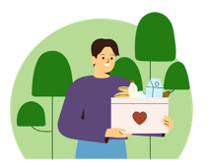
Info Sheets
Food Forests
Spring 2024
Food Forests
Resources
Websites
Boston Food Forest Coalition: https://www.mass.gov/doc/how-to-start-a-food-forest/download
Resource Library: https://www.bostonfoodforest.org/resource-library
AgLanta Resources: https://www.aglanta.org/aglanta-resources-index
Urban Farming Kit: https://www.aglanta.org/aglanta-urban-farming-kit
Sample Budget: https://static1.squarespace.com/static/5810d4f2d482e9e1f1211dfa/t/ 59ef41f2f43b55e82204f124/1508852213801/Aglanta_GrowsALot_UrbanGarden_ SampleBudget.pdf
Sample Timeline for Community Engagement: https://static1.squarespace.com/ static/5810d4f2d482e9e1f1211dfa/t/5a6a25708165f52cf60bf018/1516905840905/ Community+Engagement+Activites+to+Date+Jan+2018.pdf
Grow Family YouTube: https://www.youtube.com/@GrowFamilyNetwork/videos
Overview
Food forests are areas planted with many different edible plants of different heights and sizes. They are often arranged in patterns like natural forests with layers ranging from groundcover to tall trees. In addition to many annual plants typically grown in fruit and vegetable gardens that must be planted each year, food forests include perennial plants which do not have to be replanted year after year but will continue to grow for many years.
Food Forests
Housing and Food Forests
New construction and development approaches to affordable housing projects can include fruit and vegetable plantings within the immediate vicinity of where people are living (Via Verde | Jonathan Rose, n.d.).
Interesting Information
Multiple Benefits and Leaders
According to one database, there are currently over 85 food forests throughout the United States. Food forests often have less barriers to entry than community gardens, and are considered a way to address climate change, environmental degradation and social and racial inequity (Spiller & Kashwan, 2023).
Food forests can provide healthy food to eat as well as places to gather and stay healthy in the shade (Spiller & Kashwan, 2023).
Food forests can be run by community members or city governments, such as one in Tucson, Arizona (Graham, 2024). Grants from the U.S. Forest Service can help to fund food forests, such as a 7.1 acre site in Atlanta, Georgia that provided fresh food in an area that previously had very limited access (About the Urban Food Forest at Browns Mill, n.d.).
Starting and Upkeep
Each food forest will be unique, but there are some general factors to consider. When choosing a site, consider whether it will be sunny or shady, and whether it will have water access. It
can also be good to test the soil. Plants have different preferences for sun, water, and soil conditions. Local nurseries or places that sell plants can often provide additional information about plant selection. Other preparation will likely include clearing some ground, buying new plants, and planting. (Plant Your Own Food Forest – Wisconsin Food Forests, n.d.).
Upkeep of the food forest will vary by site, but some common tasks may include weeding, mulching, pruning, clearing debris, plant propagation, and harvesting (Resource Library — Boston Food Forest Coalition, n.d.).
How-To
The Community Food Forest Handbook: https://www.serenbe.com/press-awards/the- community-food-forest-handbook-how-to-plan-organize-and-nurture-edible-gathering-places
USFS People’s Garden: https://www.usda.gov/peoples-garden/gardening-advice/trees-food- forests
Urban Farm Business Plan: https://www.epa.gov/sites/default/files/2015-10/documents/1. urban_farm_business_plan_handbook_091511_508.pdf
Particular Plants
Location will affect which types of trees will grow best in your food forest. Some examples of larger trees that you might
be able to grow are oaks, chestnuts, pecan, and mulberry. Smaller trees include apple, pear, peach, plum, hazelnut, and pawpaw (Bukowski & Munsell, 2018).
Other trees that have edible components are beech, birch, linden, maple, poplar, sassafras, elm, and willow (Trail, n.d.).
There are many types of other plants that will grow well with trees in a food forest. For example, a mulberry could pair well with some smaller flowering plants such as yarrow, purple coneflower, and chamomile (What to Plant – Project Food Forest, n.d.).
Case Studies
Bliss Meadows: Baltimore, MD
This site is a grassroots led transformation of land in a predominantly African American neighborhood of Baltimore into community gardens, food, and forest spaces (Basecamp, n.d.).
Boston Food Forest: Boston, MA
This Food Forest is a locally run neighborhood coalition with an equity focus. In a video posted on their websites, residents reflect on the importance of having a beautiful place to gather together and take care of for many years (Boston Food Forest Coalition, 2021)
References
About the Urban Food Forest at Browns Mill—AgLanta AgLanta—Urban Agriculture Atlanta. (n.d.). AgLanta. Retrieved March 10, 2024, from https://www.aglanta.org/urban-food-forest-at- browns-mill-1
Basecamp, B. (n.d.). Backyard Basecamp. Backyard Basecamp. Retrieved March 10, 2024, from https://backyardbasecamp.org/about-bliss
Boston Food Forest Coalition. (n.d.). Boston Food Forest Coalition. Retrieved March 10, 2024, from https://www.bostonfoodforest.org
Boston Food Forest Coalition (Director). (2021, May 18). Stewards Reflect on New Site Development. https://www.youtube.com/watch?v=mWGM-3ZKMrg Bukowski, C., & Munsell, J. (2018). The Community Food Forest Handbook: How to Plan, Organize, and Nurture Edible Gathering Places. Chelsea Green Publishing. Graham, M. (2024, February 7). These Urban Food Forests Do Double Duty. https://nextcity.org/urbanist-news/these-urban-food-forests-do-double-duty
Grow Family Network—YouTube. (n.d.). Retrieved March 31, 2024, from https://www.youtube.com/@GrowFamilyNetwork/videos Philadelphia Orchard Project. (n.d.). Philadelphia Orchard Project. Retrieved March 10, 2024, from https://www.phillyorchards.org/
Plant your own food forest – Wisconsin Food Forests. (n.d.). Retrieved March 31, 2024, from https://www.wisconsinfoodforests.com/take-action/plant-your-own-food-forest/
Resource Library—Boston Food Forest Coalition. (n.d.). Retrieved March 31, 2024, from https://www.bostonfoodforest.org/resource-library
Serenbe | Press and Awards—The Community Food Forest Handbook. (n.d.). Retrieved March 28, 2024, from https://www.serenbe.com/press-awards/the-community-food-forest-handbook- how-to-plan-organize-and-nurture-edible-gathering-places
Spiller, K. A., & Kashwan, P. (2023, April 4). Food forests are bringing shade and sustenance to US cities, one parcel of land at a time. The Conversation. http://theconversation.com/food- forests-are-bringing-shade-and-sustenance-to-us-cities-one-parcel-of-land-at-a-time-197388
Trail, J. V. (n.d.). Edible Trees: Foraging for Food from Forests—American Forests. Retrieved March 29, 2024, from https://www.americanforests.org/article/edible-trees-foraging-for-food- from-forests/
Trees and Food Forests | USDA. (n.d.). Retrieved March 10, 2024, from https://www.usda.gov/peoples-garden/gardening-advice/trees-food-forests
Urban Farm Business Plan Handbook. (2011).
Via Verde | Jonathan Rose. (n.d.). Retrieved March 10, 2024, from https://www.rosecompanies.com/projects/via-verde/
What is a Food Forest? – Project Food Forest. (n.d.). Retrieved March 10, 2024, from https://projectfoodforest.org/what-is-a-food-forest/
What to plant – Project Food Forest. (n.d.). Retrieved March 29, 2024, from https://projectfoodforest.org/pledge/
Philadelphia Orchard Project: Philadelphia, PA
A citywide effort to increase small places for planting fruit trees in order to address food insecurity (Philadelphia Orchard Project, n.d.).
Urban & Community Forestry Toolkit: DRAFT

Slide 20
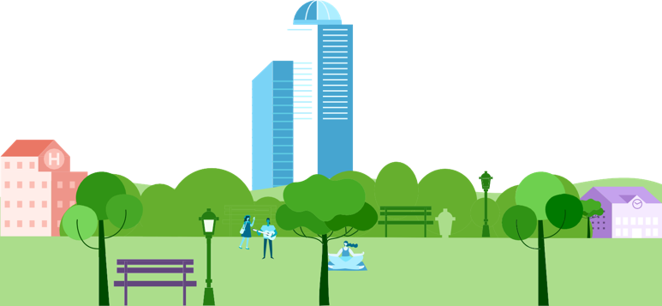
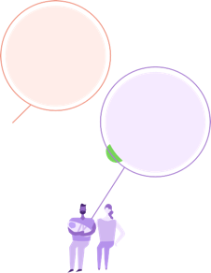
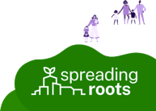
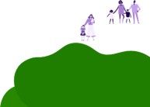
Public Outreach
Infographics
Infographics are visual representations of data and information that make complex concepts more accessible and engaging to a broad audience.
For this initiative, we developed nine pre-populated graphics, along with versions you can use to populate stats and graphics relevant to your initiatives. They communicate the benefits of trees and community gardens, which trees are best suited to your area, how green spaces can inspire community, and
where to find helpful tools to assist you in your tree planting efforts.
Plant a Tree
Watch the Benefits Grow
Rest Easy
1 DAY
Less in the hospital for patients with a green view
Get Schooled
Help Your Heart
HIGHER
Academic scores on school campuses
with more trees
Stay Cool
Form a Bond
40%
Less likely to be overweight than people in the least green settings
5.2ºF
Amount that trees can cool urban neighborhoods
INCREASED
Sense of connectedness in communities with higher tree density
S C H O O L
Rest Easy: View Through a Window May Influence Recovery From Surgery. Ulrich, R.S. 1984. (Science 224, 27: 420-21.)
Stay Cool: Urban heat island mitigation by green infrastructure in European Functional Urban Areas. Marando, F., Heris, M.P., Zulian, G., Udías, A., Mentaschi, L., Chrysoulakis, N., Parastatidis, D. and Maes, J. (2022.) Form a Bond: The Relationship Between Social Cohesion and Urban Green Space: An Avenue for Health Promotion. Viniece Jennings and Omoshalewa Bamkole. (Published online 2019 Feb 4.)
Help Your Heart: Graffiti, greenery, and obesity in adults: secondary analysis of European cross-sectional survey. BMJ 2005; 331 doi: https://doi.org/10.1136/bmj.38575.664549.F7 (Published 15 September 2005.) Get Schooled: Tree cover and species composition effects on academic performance of primary school students. Sivajanani Sivarajah, Sandy M. Smith, Sean C. Thomas (2018.)
Plant a Tree
Watch the Benefits Grow
S C H O O L

Slide 21
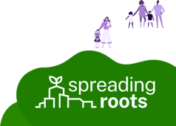
Plant a Tree
Watch the Benefits Grow
Infographics
Plant a Tree
Watch the Benefits Grow
Form a Bond
INCREASED
Sense of connectedness in communities with higher tree density
Help Your Heart
40%
Less likely to be overweight than people in the least green settings
Save It
Rest Easy
30%
Reduction in your A/C needs with a greater canopy
Get Schooled
S C H O O L
1 DAY
Less in the hospital for patients with a green view
HIGHER
Academic scores on school campuses
with more trees
S C H O O L
Rest Easy: View Through a Window May Influence Recovery From Surgery. Ulrich, R.S. 1984. (Science 224, 27: 420-21.)
Save It: Let’s carry the values of Tu B’Shevat with us every day, USDA Forest Service, https://www.fs.usda.gov/features/lets-carry-values-tu-bshevat-us-every-day (2014)
Form a Bond: The Relationship Between Social Cohesion and Urban Green Space: An Avenue for Health Promotion. Viniece Jennings and Omoshalewa Bamkole. (Published online 2019 Feb 4.)
Help Your Heart: Graffiti, greenery, and obesity in adults: secondary analysis of European cross-sectional survey. BMJ 2005; 331 doi: https://doi.org/10.1136/bmj.38575.664549.F7 (Published 15 September 2005.) Get Schooled: Tree cover and species composition effects on academic performance of primary school students. Sivajanani Sivarajah, Sandy M. Smith, Sean C. Thomas (2018.)
Urban & Community Forestry Toolkit: DRAFT

Slide 22
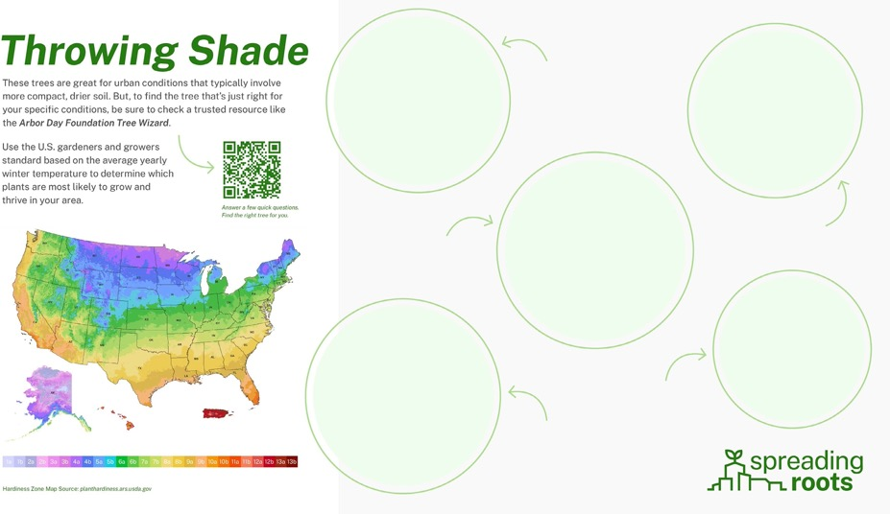
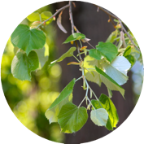
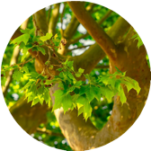
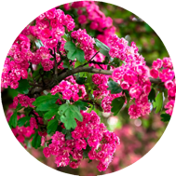
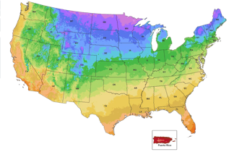
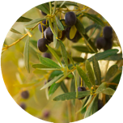
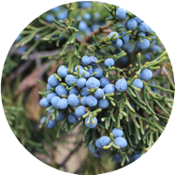
Infographics
Throwing Shade
These trees are great for urban conditions that typically involve more compact, drier soil. But, to find the tree that’s just right for your specific conditions, be sure to check a trusted resource like the Arbor Day Foundation Tree Wizard.
Silver Linden
Zones 4a–7b
Nonnative, adaptable, drought tolerant, moderate growth rate
Use the U.S. gardeners and growers standard based on the average yearly winter temperature to determine which plants are most likely to grow and thrive in your area.
Answer a few quick questions. Find the right tree for you.
Crape Myrtle
Zones 6a–10b
Summer blooms, sun lovers, tough, durable, simple to grow
London Planetree
Zones 6a–9b
Leafy, robust, hardy, pollution tolerant, fast growing
Black Olive
Zones 10b–11b
Saline tolerant, wind resistant, flowering, dense canopy
AK
PR
HI
1a 1b 2a 2b 3a 3b 4a 4b 5a 5b 6a 6b 7a 7b 8a 8b 9a 9b 10a 10b 11a 11b 12a 12b 13a 13b
Eastern Red Cedar
Zones 2a–9b
Heat-tolerant evergreen, low maintenance, bears food for wildlife
Hardiness Zone Map Source: planthardiness.ars.usda.gov
Urban & Community Forestry Toolkit: DRAFT

Slide 23
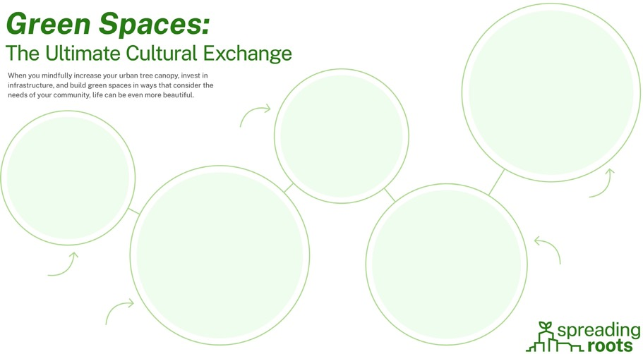
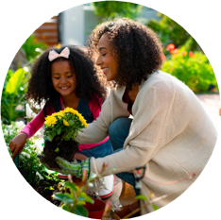
Infographics
Green Spaces:
The Ultimate Cultural Exchange
When you mindfully increase your urban tree canopy, invest in infrastructure, and build green spaces in ways that consider the needs of your community, life can be even more beautiful.
Inspire
Instill a sense of wonder in children
and provide a safe place to play
Connect
Nurture your relationship with
your natural surroundings and the world around us
Engage
Share positivity and interact with
people from different backgrounds
Reflect
Enjoy a space to meditate, relax,
write, teach, and perform
Commune
Organize events where you can
gather with friends and family
Urban & Community Forestry Toolkit: DRAFT

Slide 24
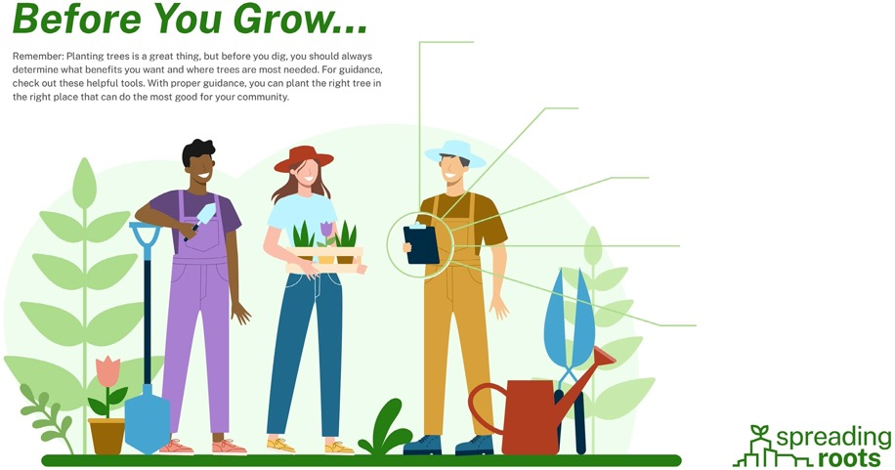
Infographics
Before You Grow...
Remember: Planting trees is a great thing, but before you dig, you should always determine what benefits you want and where trees are most needed. For guidance, check out these helpful tools. With proper guidance, you can plant the right tree in the right place that can do the most good for your community.
i-Tree
itreetools.org
Worldwide standard for discussing the benefits of trees; offers free tools and support for all
My City’s Trees
mct.tfs.tamu.edu
Urban Forest Inventory and Analysis data; produce custom analyses and reports
Treepedia
senseable.mit.edu/treepedia
Measures city tree canopy cover by analyzing the amount of green perceived while walking
EnviroAtlas
enviroatlas.epa.gov
Interactive online tool for exploring benefits of nature; helps inform pro-environment, pro-economy, planning and policy decisions
Municipal Planning Office
Contact your local government
Works to ensure safe and appropriate growth of your community by guiding the social, physical, economic, and environmental development
Urban & Community Forestry Toolkit: DRAFT

Slide 25
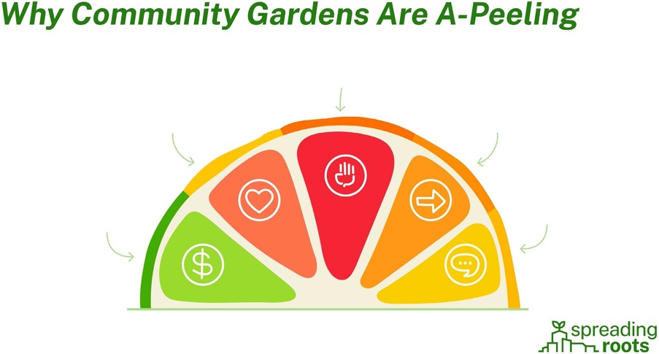
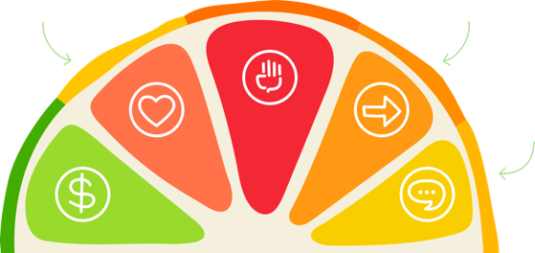
Infographics
Why Community Gardens Are A-Peeling
Empowering
Get your hands in the dirt. Plant a seed. Watch it grow!
Healthy
Lower food security is associated with a higher probability of chronic diseases.¹
Efficient
Improve access to fresh, healthy food that could be more expensive in stores.
Economical
A 600-square-foot garden costs
$70/year to maintain on average, but could produce 300 lbs. of food worth nearly $600!²
Social
Nourish your neighbors and revitalize your community while bonding over a shared goal.
¹ Gregory, Christian A. & Coleman-Jensen, Alisha, 2017. "Food Insecurity, Chronic Disease, and Health Among Working-Age Adults,"Economic Research Report 261813, United States Department of Agriculture, Economic Research Service.
² https://money.com/gardening-grocery-savings/#:~:text=A%20well%2Dmaintained%20food%20garden,%24600%20annually%2C%20the%20association%20estimates.
Urban & Community Forestry Toolkit: DRAFT

Slide 26
Infographics
Environmental Benefits
Trees, green spaces, and nature provide crucial environmental benefits to urban areas.
Green spaces create wildlife corridors in cities essential for the survival of urban wildlife.”
Green Canopy, Better World: Exploring the benefits of trees. (n.d.). Gardenia -Creating Gardens. https://www.gardenia.net/guide/green-canopy-better-world-benefits-of-trees
Urban & Community Forestry Toolkit: DRAFT

Slide 27
Infographics
Community Well-Being
Strong social connections have been linked to improved health and well-being.
Environmental Benefits
Trees, green spaces, and nature provide crucial environmental benefits to urban areas.
Food Forests
Supporting ecosystems and connecting communities with nature.
Food forests are areas planted with many different edible plants of different heights and sizes. They are often arranged in patterns like natural forests with layers ranging from groundcover to tall trees. In addition to many annual plants typically grown in fruit and vegetable gardens that
must be planted each year, food forests include perennial plants which do not have to be replanted year after
year but will continue to grow for many years.
Urban & Community Forestry Toolkit: DRAFT

Slide 28
Public Outreach
Media Scripts
Radio scripts allow you to tell your story. You can raise public awareness about the importance of trees, green spaces, and nature while educating your community about your program and promoting your events. Here are three templates, each using a different benefit of green spaces, for you to determine which connects with the broadest audience.
Universal
Imagine a community where community gardens grow, trees offer shade and protect water quality, and green spaces provide a peaceful place for connection and introspection. Oh, and these benefits are for everyone to enjoy. That’s what the Spreading Roots initiative is all about. We’re on a mission to improve communities and lives. It starts by preserving and protecting the spaces where we live. And we want you to join us. Come to <EVENT> on <DATE> to learn more about our work and how together we can help our community and residents thrive. Dig into our initiative on <WEBSITE>. We know that the roots of a community hold it together. So, let’s build a stronger foundation together. We’ll see you at <EVENT> on <DATE>.
Economic & Ecological Resilience
Imagine a community where residents don’t simply plant trees or grow green spaces, they mindfully invest in the vibrancy of their community. This is a place where every act of
beautification – from cultivating a community garden to implementing green infrastructure – counts toward protecting the wellbeing of our people and our planet. That’s what the Spreading Roots initiative is all about. We’re on a mission to build a more resilient community that we can enjoy for years to come. And we want you to join us. Come to <EVENT> on <DATE> to learn more about our work and how together we can help our community and residents thrive. Dig into our initiative on <WEBSITE>. We know that the roots of a community hold it together. So, let’s build a stronger foundation together. We’ll see you at <EVENT> on <DATE>.
Community Well-being
Imagine a community where every resident has access to nature…where people have a sense of pride in their green spaces and use them as invaluable places to connect, learn, and
collaborate. Places where they can make new friends, meet up with old ones, or simply unwind. That’s what the Spreading Roots initiative is all about. We’re on a mission to unite people around a common cause in common spaces that enrich, engage, and inspire. And we want you to join us. Come to <EVENT> on <DATE> to learn more about our work. Dig into our initiative on
<WEBSITE>. We know that the roots of a community hold it together. So, let’s build a stronger foundation - and a deeper connection - together. We’ll see you at <EVENT> on <DATE>.

Slide 29
Public Outreach
Media Scripts
Radio scripts allow you to tell your story. You can raise public awareness about the importance of trees, green spaces, and nature while educating your community about your program and promoting your events. Here are three templates, each using a different benefit of green spaces, for you to determine which connects with the broadest audience.
Health
Imagine a city where trees stand tall, providing shade and fresh air… where gardens grow, and everyone feels connected to the earth and land. That’s what the Spreading Roots initiative is all about. We’re on a mission to improve our community’s health and happiness by planting and caring for more trees and preserving our green spaces. And we want you to join us. Come to <EVENT> on <DATE> to learn more about our work. Dig into our initiative on <WEBSITE>.
We know that the roots of a community hold it together. So, let’s build a stronger foundation together. We’ll see you at <EVENT> on <DATE>.
Equity
Imagine a city where every resident has access to green spaces… where gardens grow, and everyone feels connected to the earth and land. That’s what the Spreading Roots initiative is all about. We’re on a mission to build up our community by planting and caring for more trees and preserving our green spaces. And we want you to join us. Come to <EVENT> on <DATE> to learn more about our work. Dig into our initiative on <WEBSITE>. We know that the roots of a community hold it together. So, let’s build a stronger foundation together. We’ll see you at
<EVENT> on <DATE>.
Youth
Imagine a city where our youngest residents can experience the wonder of nature… where they can grow gardens, get their hands in the dirt, and learn about the earth and land. That’s what the Spreading Roots initiative is all about. We’re on a mission to build up our community by planting and caring for more trees and preserving our green spaces. And we want you to join us. Come to <EVENT> on <DATE> to learn more about our work. Dig into our initiative on
<WEBSITE>. We know today’s children are future leaders of our community. So, let’s nurture them together. We’ll see you at <EVENT> on <DATE>.

Slide 30
Public Outreach
Phone Scripts
Phone scripts are a way to directly communicate with community members, stakeholders, and potential supporters. With these, you can personally invite community members to tree-planting events,
workshops, or informational sessions, creating a sense of connection and importance.
Remember to communicate your message clearly, persuasively, and in a friendly manner following these suggested steps:
Greet the person and introduce yourself
Establish interest by highlighting the importance of urban and community forestry (Hint: Use a brief, compelling fact or story)
Explain your initiative and event, if applicable
Discuss the benefits of involvement
Address questions or concerns
Close by thanking the participant for their time, provide contact information, and discuss any next steps (Ex. Informational material, event invitation)
Here we have three phone scripts that follow the same format. However, the difference lies in how your
initiative is positioned: as a national movement, a crucial component of a national movement, or a community- driven campaign.
Community Driven
Intro
Caller: Hello! This is <Name> from Spreading Roots. Am I speaking with <Recipient’s Name>? Recipient: Yes, this is <Name>. How can I help you?
Purpose
Caller: Great! I’m reaching out to tell you a little bit about Spreading Roots, a national initiative designed to support community-led urban forestry, so that people can have a voice in creating and preserving the right green spaces in our neighborhoods. Because we know that when we come together, we can create a better community for us all to enjoy.
Highlighting Mission
Caller: Our mission is to <INSERT MISSION STATEMENT>.
Engagement
Caller: Have you ever thought about the benefits of having more green spaces in <PLACE>, like
<INSERT BENEFITS>?
Invitation
Caller: We’re inviting community members to join us in our upcoming <EVENT> on <DATE> at
<LOCATION>. It’s a fantastic opportunity to get involved, meet other people who care about our town, and help us create a more vibrant community.
Call-to-Action
Caller: Would you be interested in joining us for the event or learning more about Spreading Roots and our community initiatives? Your support can make a real difference.
Closing
Caller: Thank you so much <NAME>. We appreciate your time and your interest. Feel free to visit our website or contact us at <NUMBER> for more details. I’m really looking forward to making positive changes in our community with you!

Slide 31
Phone Scripts
National Movement
Intro
Caller: Hello! This is <Name> from Spreading Roots. Am I speaking with <Recipient’s Name>? Recipient: Yes, this is <Name>. How can I help you?
Purpose
Caller: Great! I’m reaching out to tell you a little bit about a national initiative called Spreading Roots. It’s designed to support urban forestry led by the people and for the people. Because we know that greater access to nature can dramatically improve people’s lives. And yet, there is a drastic inequity in who has access to it. So, we’re giving people a voice in creating and preserving the right green spaces in our neighborhoods. Because then we can create a better community that we all can enjoy.
Highlighting Mission
Caller: Our mission is to <INSERT MISSION STATEMENT>.
Engagement
Caller: Have you ever thought about the benefits of having more green spaces in <PLACE>, like <INSERT BENEFITS>?
Invitation
Caller: We’re inviting community members to join us in our upcoming <EVENT> on <DATE> at
<LOCATION>. It’s a fantastic opportunity to get involved, meet other people who care about our town, and help us create a more vibrant community.
Call-to-Action
Caller: Would you be interested in joining us for the event or learning more about Spreading Roots and our community initiatives? Your support can make a real difference.
Closing
Caller: Thank you so much <NAME>. We appreciate your time and your interest. Feel free to visit our website or contact us at <NUMBER> for more details. I’m really looking forward to making positive changes in our community with you!
Umbrella
Intro
Caller: Hello! This is <Name> from Spreading Roots. Am I speaking with <Recipient’s Name>? Recipient: Yes, this is <Name>. How can I help you?
Purpose
Caller: Great! I’m reaching out to tell you a little bit about <NAME>, a local initiative that’s part of the national Spreading Roots campaign that supports urban forestry led by the people and for the people. We know that greater access to nature can dramatically improve people’s lives. And yet, here in <PLACE>, there is a drastic inequity in who has access to it. So, we’re giving people a voice in creating and preserving the right green spaces. Because then we can create a better community that we all can enjoy.
Highlighting Mission
Caller: Our mission is to <INSERT MISSION STATEMENT>.
Engagement
Caller: Have you ever thought about the benefits of having more green spaces in <PLACE>, like <INSERT BENEFITS>?
Invitation
Caller: We’re inviting community members to join us in our upcoming <EVENT> on <DATE> at
<LOCATION>. It’s a fantastic opportunity to get involved, meet other people who care about our town, and help us create a more vibrant community.
Call-to-Action
Caller: Would you be interested in joining us for the event or learning more about Spreading Roots and our community initiatives? Your support can make a real difference.
Closing
Caller: Thank you so much <NAME>. We appreciate your time and your interest. Feel free to visit our website or contact us at <NUMBER> for more details. I’m really looking forward to making positive changes in our community with you!

Slide 32
Public Outreach
Elevator Speeches
Elevator speeches provide a concise, compelling, and memorable message that can be delivered quickly, like in the time it takes to ride an elevator. They are often the first point of contact between campaigns and individuals who may not be familiar with your initiative. A well-crafted speech creates a positive first impression and raises awareness about your goals.
Here again, we’ve explored positioning as a national movement, a crucial component of a national movement, or a community-driven campaign to determine the highest engagement.
Words in bold are unique to each elevator speech.
National
Spreading Roots is a national initiative that gives people the support they need to build up their urban and community spaces and turn them into thriving green spaces. We believe in the power of community-driven change. By planting trees, nurturing green spaces, and uniting neighborhoods, we can create healthier, happier cities for us all to enjoy. Join us in
this movement. Together we can make our cities more equitable and more resilient, one tree and one plant at a time.
Community
Spreading Roots is a national initiative that supports urban and community forestry led by the people and for the people. We assist people when they want to build up their urban and
community spaces and turn them into thriving green spaces. By planting trees, nurturing green spaces, and uniting neighborhoods, we can create healthier, happier cities for us all to enjoy.
Join us in this movement. Together we can make our cities more equitable and more resilient, one tree and one plant at a time.
Umbrella
<NAME> is the local arm of Spreading Roots, a national initiative that gives people the support they need to build up their urban and community spaces and turn them into thriving green spaces. We believe in the power of community-driven change. By planting trees, nurturing green spaces, and uniting neighborhoods, we can create healthier, happier cities for us all to enjoy. Join us in this movement. Together we can make our cities more equitable and more resilient, one tree and one plant at a time.

Slide 33
Public Outreach
PowerPoints
PowerPoint presentations are an effective way of organizing multiple complex ideas into an easily digestible format. Use PowerPoint when presenting to government stakeholders, community members, or peers within the urban and community forestry professional ecosystem.
Spreading Roots has developed two simple, clean PowerPoint templates. Keeping the design of the presentation minimal allows for audiences to focus on what truly matters: your message.

Slide 34
Public Outreach
Video Scripts
Studies have shown that people retain 80% of what they see. Further, in the second quarter of 2023, it was reported that online videos had a 92.3% audience reach. With these powerful statistics in mind,
videos could do a world of good for your urban and community forestry initiative. They can do everything from raise awareness about your organization, educate others about the benefits of green spaces, showcase community success stories, and even promote engagement.
This is a video script that promotes the Spreading Roots movement while highlighting the benefits of equal access to nature.
 | Video | Voiceover and/or On-Screen Text
Frame 1 | Animated Spreading Roots logo.
Frame 2 | Group of volunteers at a planting event. | “Join a community-driven movement...”
Frame 3 | Young families or groups of children interacting with an urban green space. | “… that understands that trees and green spaces can affect our present and shape our future. “
Frame 4 | Vibrant park or parklet, teeming with activity. | “And that everyone should access.”
Frame 5 | Aerial view of densely populated urban area with a healthy tree canopy. | “Urban green spaces aren’t just beautiful... they’re vital.”
Frame 6 | Group of individuals harvesting fruits, vegetables, and greens in a community garden. | “They connect us, make neighborhoods more vibrant, and foster a sense of community.”
Frame 7 | Spreading Roots logo and URL. | “Join our cause today. Together, we can nourish a more beautiful world.”

Slide 35
Thank you.
We want to express our profound gratitude for working tirelessly to advance, protect, and preserve trees, green spaces, and nature in under-resourced communities. Your dedication, passion, and commitment to creating more vibrant places that everyone can enjoy are extraordinary. Together, we can spark a movement that drives meaningful and lasting change.
Get in touch at spreadingroots.org/contact-us.
DRAFT

